Slide 1
Lessons Learned through the Development and Publication of AstroImageJ
Karen Collins
Harvard-Smithsonian Center for Astrophysics
kcollins@cfa.harvard.edu
Development Collaborators: John F. Kielkopf, Keivan G. Stassun, Frederic V. Hessman
Thursday, January 11th, 2018

Slide 2
AstroImageJ – Public Release?
Spent ~2 years developing code to support my research
Had no intentions of releasing to public
Became involved in KELT Follow-up network
Other KELT-FUN observers asked how I reduced data
Posted a publically available version on UofL’s website
Notes:
Briefly discuss challenges to detecting and confirming such long period, long duration, shallow transits

Slide 3
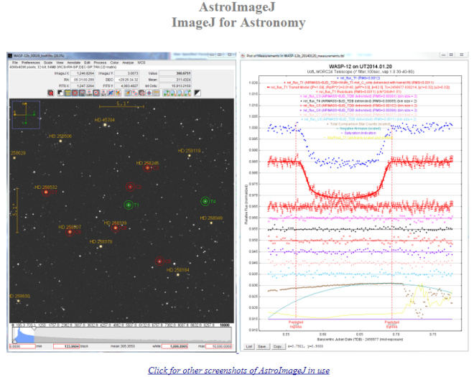
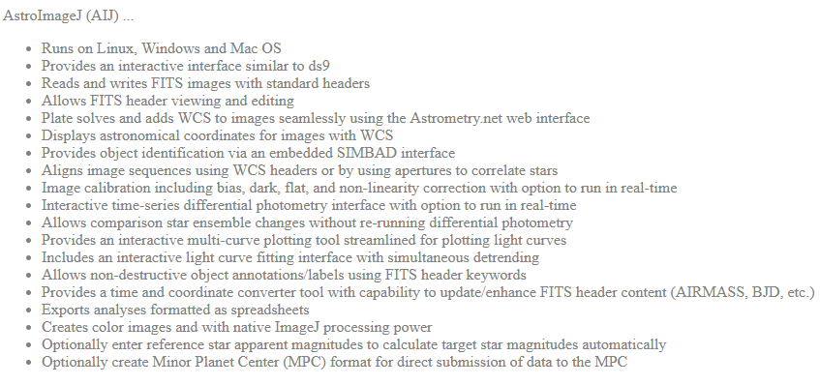
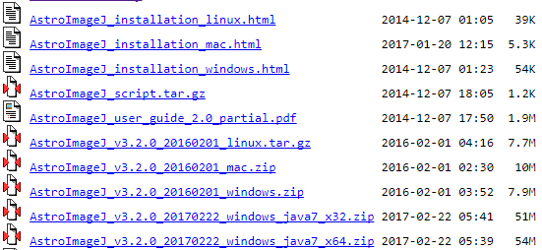
AstroImageJ Website
Screen shots
Feature overview
Documentation
Installation packages
Release notes
Notes:
Briefly discuss challenges to detecting and confirming such long period, long duration, shallow transits

Slide 4
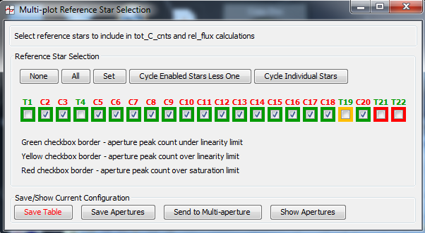
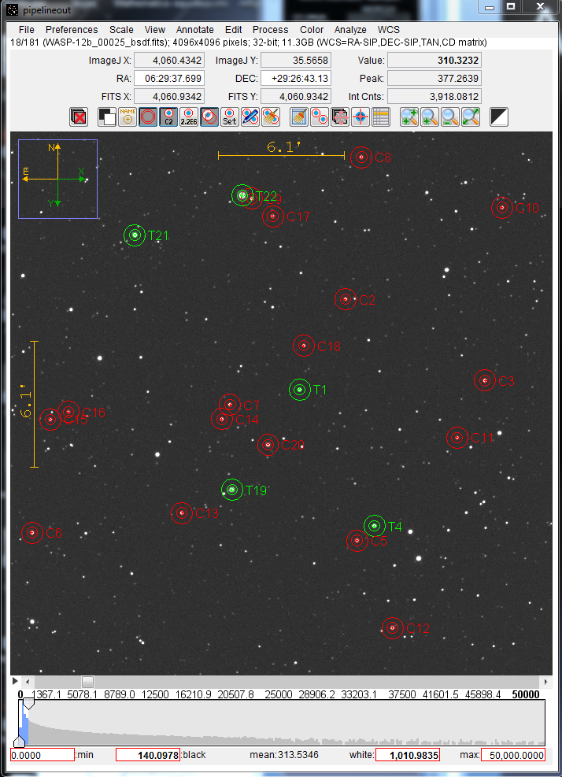
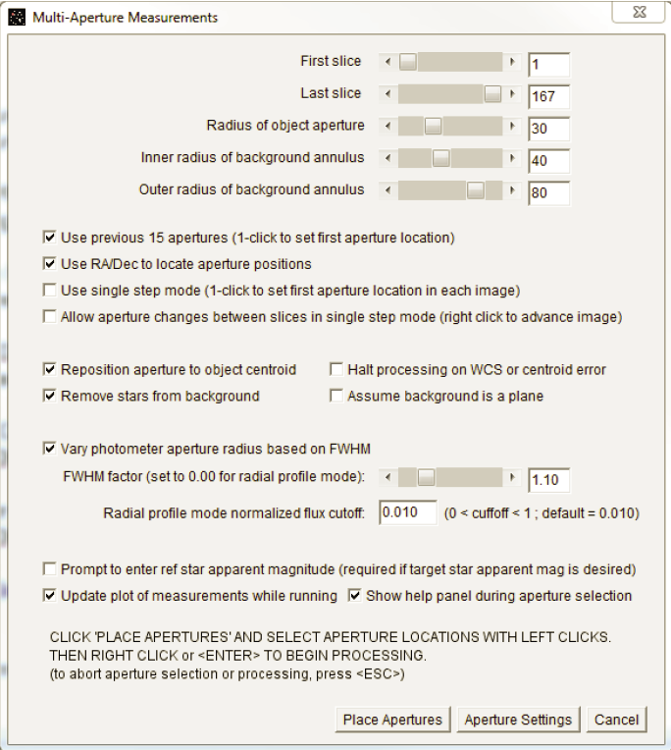
AstroImageJ – What is it?
Astronomical data reduction
Image display & analysis
Time-series diff photometry
Java, so runs on all platforms
GUI driven
Notes:
Briefly discuss challenges to detecting and confirming such long period, long duration, shallow transits

Slide 5
AstroImageJ – Publication Path
KELT-FUN users were perfect “focus group” – great feedback
AIJ results started appearing in journals, needed citable reference
Next step - Astrophysics Source Code Library
Easy to publish, permanent
Provided citable reference
Link to AIJ website
Users outside my collaboration started to adopt AIJ
Needed additional documentation to reduce support load
Astronomical Journal started new software publication policy
Published in AJ (expected good exposure to our potential user)
Notes:
Briefly discuss challenges to detecting and confirming such long period, long duration, shallow transits

Slide 6
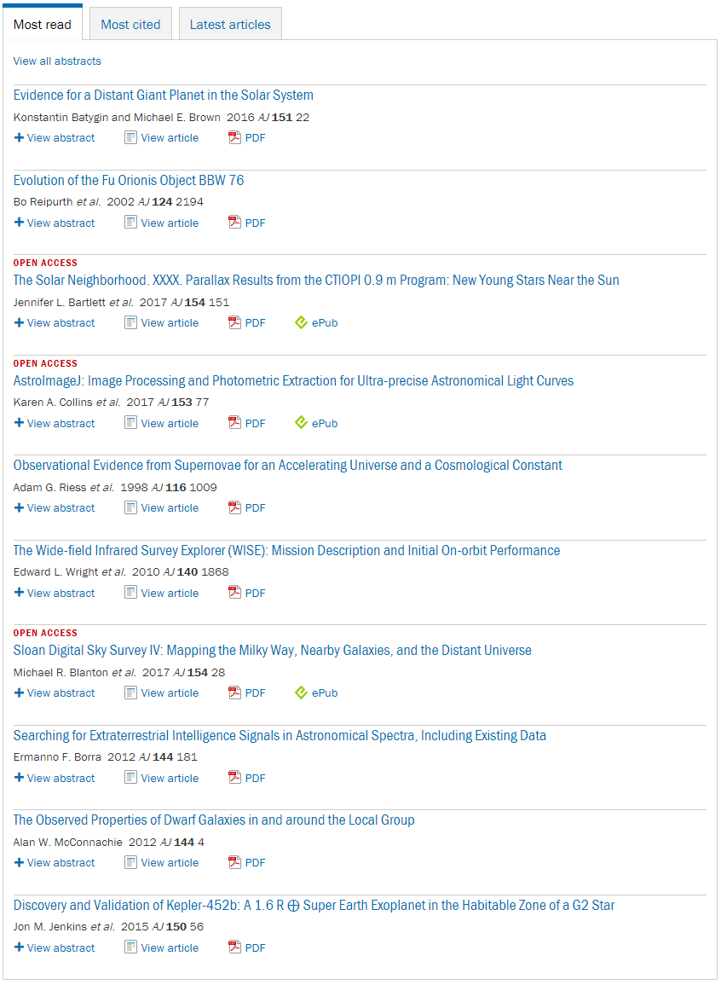
AstroImageJ – Publication Results
AJ seems to have been good fit
4th on AJ “most read” list
~4000 downloads in first year
AIJ now being adopted by “citizen observer / citizen scientists”…
…so Open Access probably helps
Notes:
Briefly discuss challenges to detecting and confirming such long period, long duration, shallow transits

Slide 7
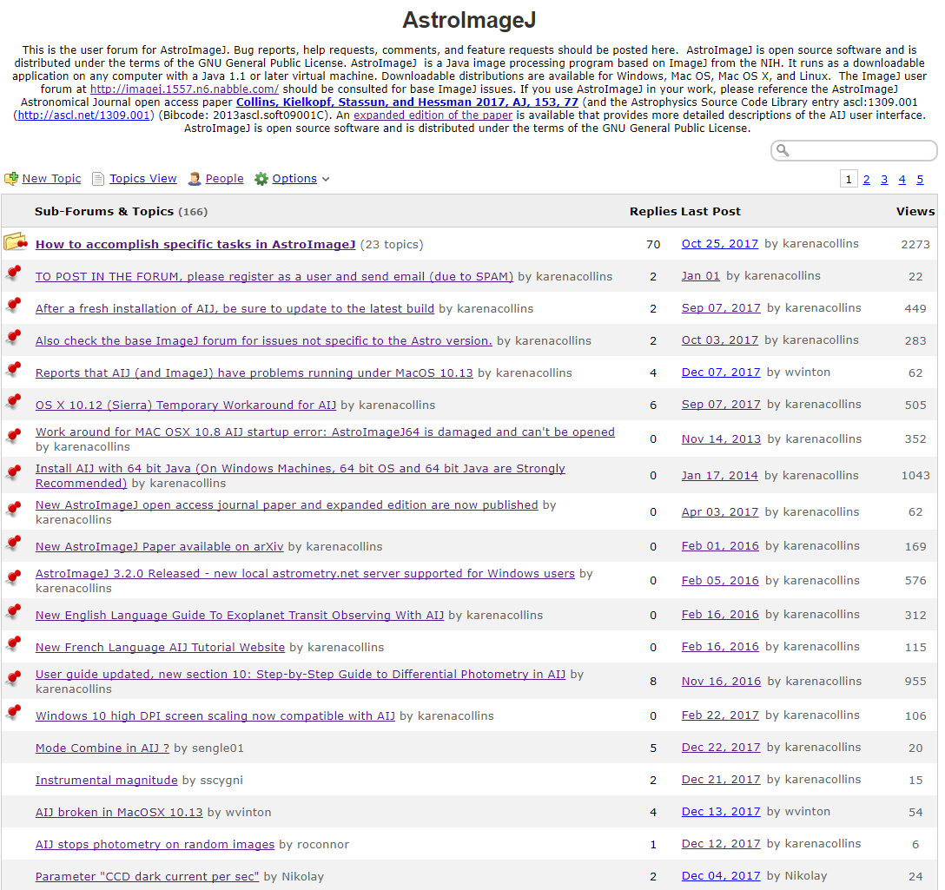
AstroImageJ – Support
Original support via email
Many users -> too much support
User forum helped
Responses to questions online
Searchable
Other users can answer questions
Selected Nabble (free)
Include citation information
Include licensing information
GNU General Public License for AIJ
Notes:
Briefly discuss challenges to detecting and confirming such long period, long duration, shallow transits

Slide 8
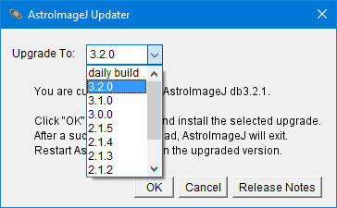
AstroImageJ – Software Updates
Important to provide simple updates
Periodic numbered releases
“daily build”
For quick fixes
Let user confirm fix before release
All to revert to old versions for debugging
Notes:
Briefly discuss challenges to detecting and confirming such long period, long duration, shallow transits

Slide 9
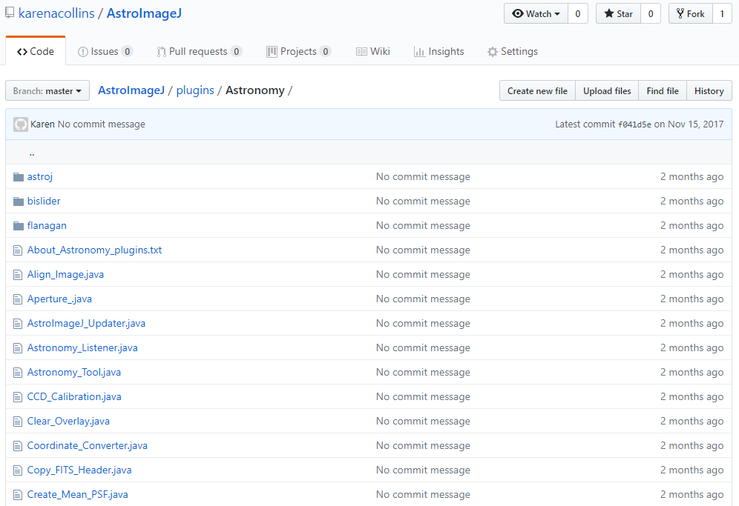
AstroImageJ – Source Code Distribution
Source code is Java
Source is included in download package “jar” executable file
Also available on online repository github
Helpful for coordinating multi-person and/or multi-site development
Notes:
Briefly discuss challenges to detecting and confirming such long period, long duration, shallow transits

Slide 10
AstroImageJ – Lessons Learned
Choose dev. environ. that supports Windows, Linux, OS X
Provide easy installation and update methods
Build an early small user base to get feed back
Specify how your software is licensed
Publish early to ASCL for permanent citable link
Publish to a journal as code matures
Provide online forum for support
Make source code easily accessible
Notes:
Briefly discuss challenges to detecting and confirming such long period, long duration, shallow transits

