Slide 1
Restoring reproducibility: Making scientist software discoverable
Source codes are increasingly important for the advancement of science in general and astrophysics in particular. Journal articles meant to detail the general logic behind new results and ideas often do not make the source codes that generated these results available, decreasing the transparency and integrity of the research. The Astrophysics Source Code Library (ASCL) is a registry of scientist-written software used in astronomy research. The challenges of creating and growing the resource will be covered by its current editor, who will also discuss specific steps the ASCL has taken to improve code discovery in astronomy and the effect this work is having within astronomy and more broadly in other research areas.

Slide 2
Restoring reproducibility:
Making scientist software discoverable
Alice Allen
ASCL, Editor
02/12/15 NIST
Notes:
Here to talk about the effort in astronomy to make research software available for examination, the Astrophysics Source Code Library (ASCL), which is an online registry scientist written software used in research
Challenges of creating and growing the resource
Specific steps the ASCL has taken to encourage use of resource and to improve code discovery in astronomy
Effect this work is having within the field and more broadly
So we will start with a journey three stops along the way: Versions 1, 2, and 3 of the ASCL, but first, I want to make sure we’re operating under the same assumptions.

Slide 3
Assumptions
Software is important in research
Research software should be available
“… anything less than release of actual source code is an indefensible approach for any scientific results that depend on computation...”
Ince, Hatton, & Graham-Cumming, The case for open computer programs, Nature, v. 482, Feb. 23, 2012
Notes:
Starting with two assumptions about what you believe….
That software is important in research – it is a method, generates results, enables discovery…
And that research software should be available so that others can examine it.
Or to paraphrase a bit in Nature in 2012: not making the software available is indefensible
And that is why the ASCL was created in 1999 – to make the source codes – the software -- used in astronomy available for examination.
We’ll first look at the three stops on ASCL’s journey
Then discuss what we learned along the way
How we put the lessons to use and finally
Effects of our work

Slide 4
ASCL First stop, 1999-2003
Notes:
So our first stop is the original ASCL

Slide 5
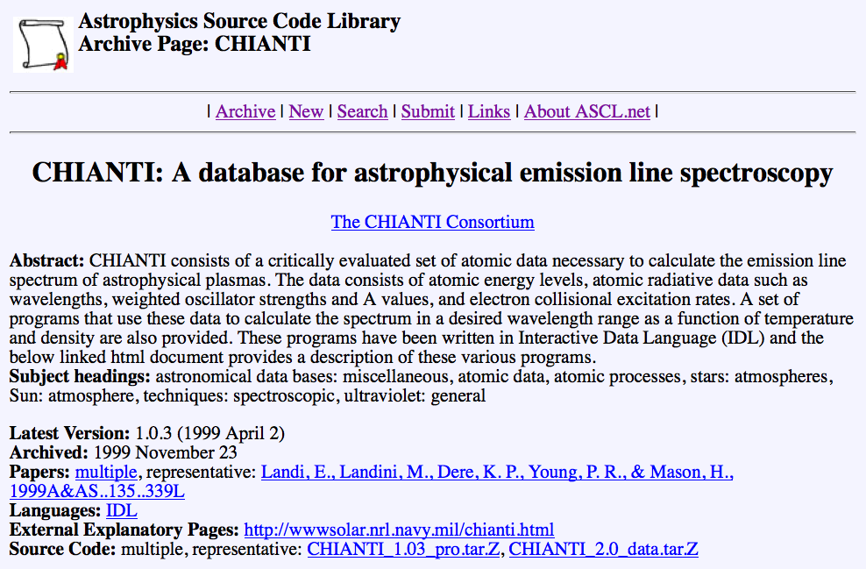
Code entry, 1999
Notes:
Started by Robert Nemiroff in 1999 – to make the source codes – the software -- used in astronomy available for examination.
This is what the first version looked like…. One HTML page/code, with 10 fields, including subject headings, version number, language(s), and a link to the deposited code
Repository
Subject headings categorized the codes, and these headings were used on an index page that listed all codes

Slide 6
Home page, 1999
Notes:
Can see here the index page
two presentations at major astronomy meetings: 1999 and 2000
37 codes
Search for new editor in 2003 was unsuccessful
Entered period of dormancy as other similar efforts were started
Continued to be available to anyone who could find it; lots of old links to it

Slide 7
ASCL Second stop, 2010-2014
Notes:
Volunteer enlisted to move codes from old site to new site
Most old codes still available!
New site: phpbb site; discussion site for popular astronomy website (Astronomy Picture of the Day – APOD). Could do this because Nemiroff, who started ASCL, is one of two editors of APOD, and he owns the discussion site.

Slide 8
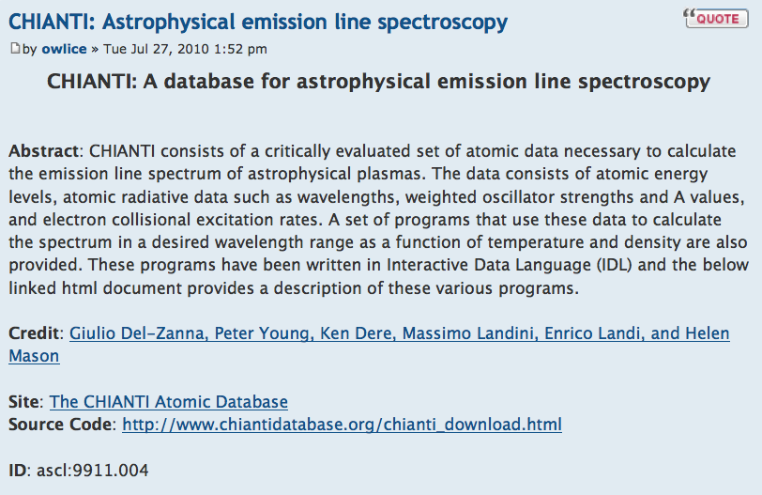
Code entry, 2010
Notes:
Dropped requirement to house codes, though still can; now link to website from which code can be downloaded
Dropped subject headings/categories in favor of full-text search – Google beats Yahoo!
And dropped language and version fields.
Added unique identifier, the ascl ID.

Slide 9
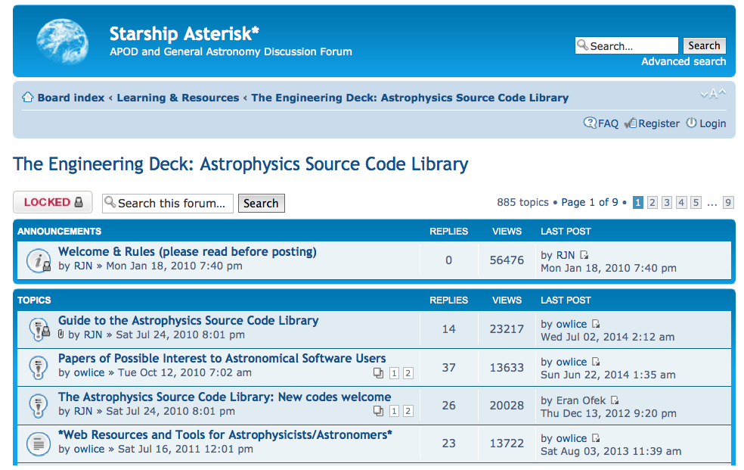
Home page, 2010
Notes:
Typical phpbb look; we used threads to store information about the ASCL – what it is, how to submit codes, interesting papers and tools.

Slide 10
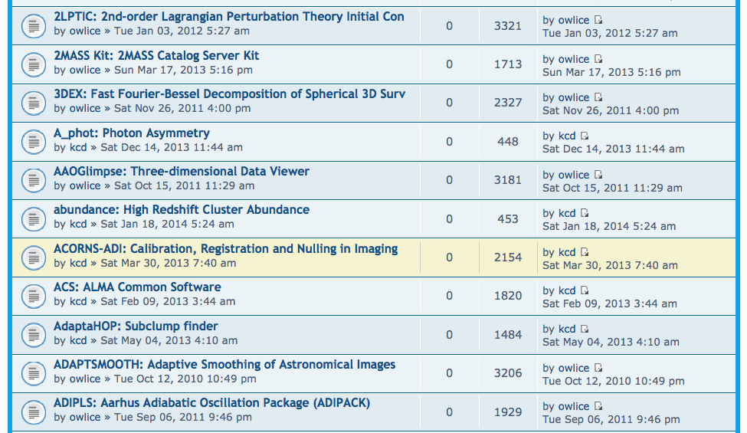
Home page, 2010
Notes:
Codes were listed in alphabetical order, 100 per page. Searching could be done by the iterative full-text search function built into the message board.
After moving codes over, Nemiroff would occasionally send new ones to me to add. Eventually, I started seeking codes out and looking for and at other efforts.
We got complaints, mostly from journal publishers, that the ASCL didn’t look very professional. They made it very clear they thought its look was holding it back. So we moved on to our third stop…

Slide 11
ASCL Third stop, 2014-present
Notes:
One of the other admins on the APOD discussion forum learned of the opinion of publishers – and a few others – about the look of the ASCL, so volunteered to build a new site backed by a MySQL database; this was implemented in July, 2014.

Slide 12
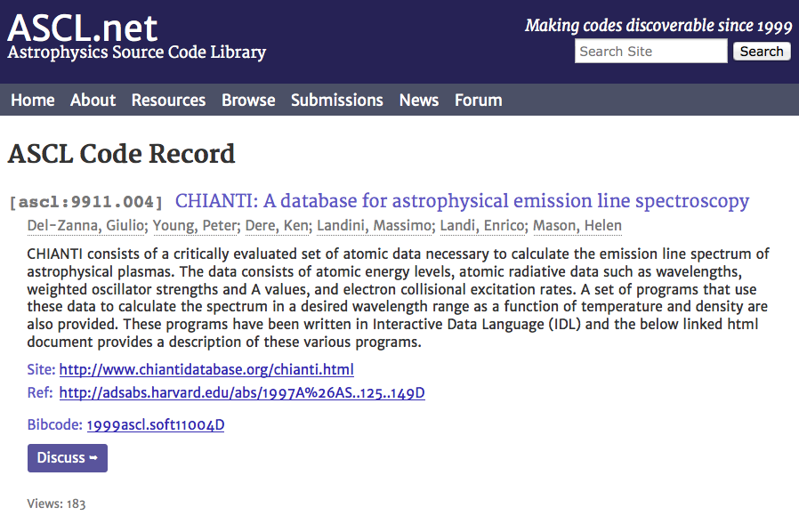
Code entry, present
Notes:
As you can see, the look is more professional. We retained the metadata from the previous version – it is still very light – and added a link to the discussion thread. We basically retained the message board, moving it to a new site, but made it subordinate to the MySQL system.
The designer incorporated a blog we had been using with the old site into this new site, under News, and improved the browsing and submissions process. The MySQL database allows us to better integrate with ADS, the primary indexer of astro journals; we create the bibcode ADS uses for our entries, and added the link to the ADS entry for our record to the page.

Slide 13
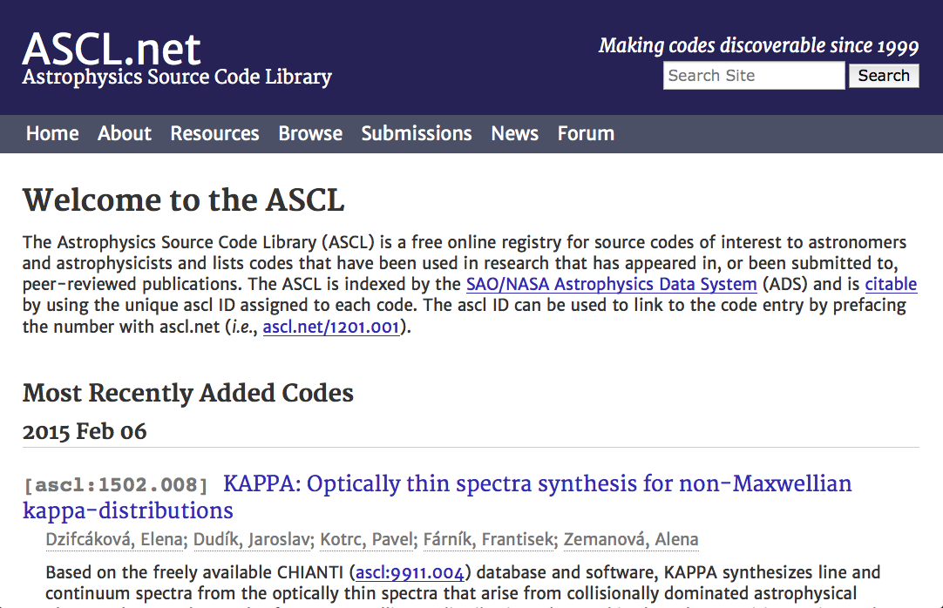
Home page, present
Notes:
This is the home page. It is much cleaner that the old discussion forum, and lists the 10 newest codes right on the page in reverse date order, making it easy for people to see what’s new.

Slide 14
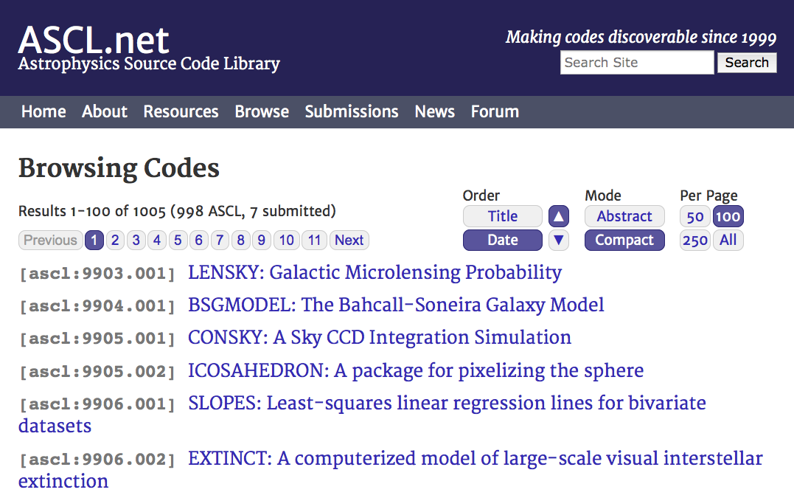
Browse, present
Notes:
Browsing options were expanded, too; this shows a compact browsing screen, which lists just the ASCL ID and the name of the software; there is an expanded mode that displays abstracts, too.

Slide 15
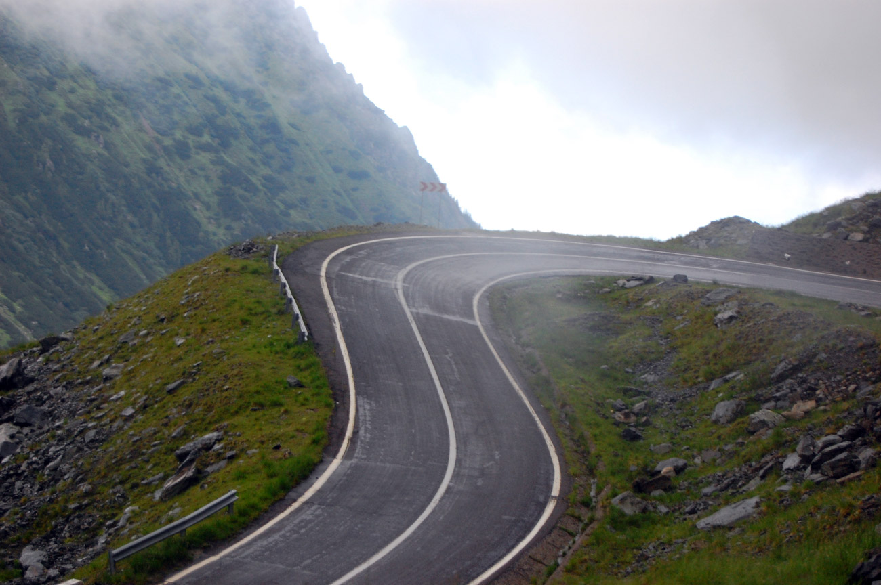
alegri / 4freephotos.com
Notes:
So the road wasn’t straight or always obvious. When Nemiroff started the ASCL to provide a place to present research codes to others, he had a few thoughts about it…
“I figured this would be popular.
I figured that people who received grant money to develop codes would want to gain as much exposure for these codes as possible.
I figured that astronomers would want to show the world their coding skills and allow their codes to be used by others.
I figured wrong.”
He has said that getting people to post their software was like pulling teeth, that no one submitted anything – he had to go out and find the codes himself. He also realized that except for a flurry of interest in response to the two poster presentations he’d done on the ASCL, people forgot about it or hadn’t learned about it. It needed more marketing than he was able to do for it.

Slide 16
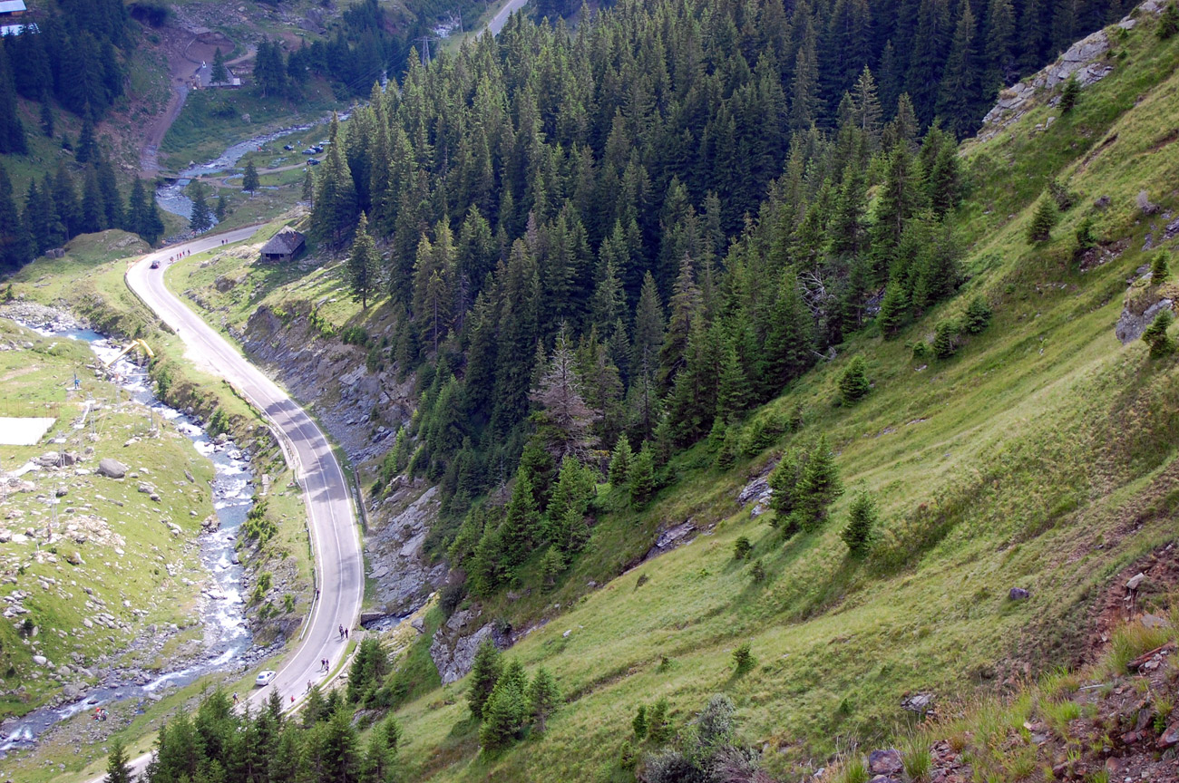
alegri / 4freephotos.com
Notes:
When I took over the ASCL, I decided I’d better look for and at other similar efforts. The most robust of these was started by Bob Hanisch in 1993, so pre-dated the ASCL. It indexed software and other resources useful in astronomy, and was one of several I looked at that were funded. It closed when its funding ended in 2000; at least five other efforts started up after that, only one of which remains today and which is not very active.
I asked some of those involved in these other efforts what had worked well and what had not worked for them.

Slide 17
Other efforts
ASDS (most robust; funded; 1993-2000)
AstroForge (funded, 2003-2006)
SkySoft (2003-present)
Astro-Code Wiki (2006-2011)
Astro-Sim (2007-2010)
AstroShare (2008-2014; last update 2012)

Slide 18
Lessons learned
People don’t want to deposit their codes/like to keep their codes nearby
Little incentive to register software
Don’t want to go first
Don’t want to have another site to update
Funding cycle not long enough to get uptake by community
Authors will not update metadata
Limited marketing limited growth
Notes:
So with these lessons in mind, the question then how do we use what we’ve learned? How do we encourage software release in the community? Framed this way, it’s a change management issue, and change management has been well-studied and offers guidance.

Slide 19
To bring about change …
Build it
Enlist/involve others
Market, market, market
Engage the community
Learn what barriers and incentives exist
Mitigate barriers and nurture incentives
Be patient
Notes:
Here are the most important steps we identified as necessary to change astronomy to a community that shares software more openly and that can guide the ASCL to being more widely adopted.

Slide 20
Total code entries by quarter July, 2010 - September, 2011
Notes:
Make it look like something; we had the infrastructure already, even though it was “just” a phpbb.
Since software authors won’t enter their codes, I decided we’d take on that task.
The first 1.5 years I worked on the ASCL, much of my time was spent simply tracking down and entering codes.
This graph shows the results of that work, and was created for the first presentations on the ASCL since 2000.

Slide 21
Number of code entries at year end, 2010 - 2014
2010
2011
2012
2013
2014
Notes:
We’ve continued to build it, and this is easier now as more and more, software authors are submitting their codes. We now have over 1000 codes in the ASCL

Slide 22
Advisory Committee
Notes:
To enlist and involve others, we created an advisory committee. We selected people who provide credibility and knowledge
To inform effort
To serve as change champions
Enlisted people prominent in astro software community, computer science professors with ties to other fields, and others
Eight members on advisory committee by end of 2011; ten members currently
Email others interested in code release and sharing to let them know the ASCL exists

Slide 23
Get the word out
Notes:
Market, market, market! The chair of the ASCL AC and I devised a marketing plan for the ASCL, which includes
Linking from Astronomy Picture of the Day (APOD) to ASCL
Participating in meetings/conferences and associated papers
Writing to code authors upon software registration
Writing guest posts for popular astro blogs
Getting involved in open science discussions with others
Using social media – Facebook, Twitter, and G+

Slide 24
Community work
Notes:
Educate and engage the community
Organize sessions at astronomy meetings
Split allotted time between presentations and open discussion with attendees to learn:
Barriers to code sharing
Incentives to encourage sharing
Community expectations
Participate in “hack” events when possible

Slide 25
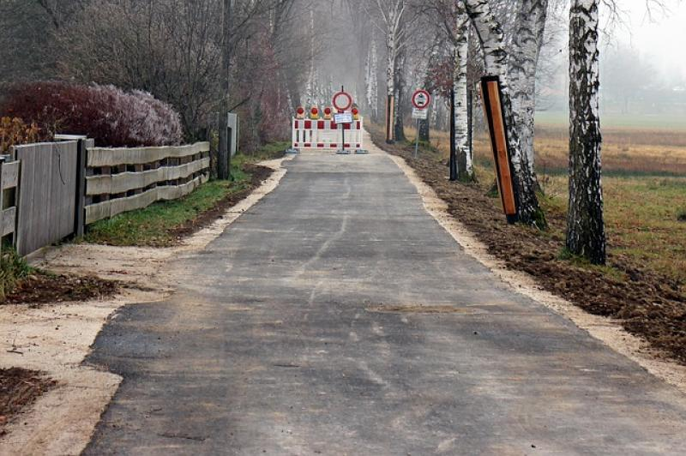
Notes:
4a. Barriers
No payback/benefit to sharing software
Not required to, so don’t/too busy to do more work
Fear of judgment for “messy” code
Fear of losing competitive edge
University policies
Expectation of support from community
http://www.pd4pic.com/road-works-site-street-away-barrier-warning-stop.html

Slide 26
No one can assume that valuable innovations will pop up magically in the public domain if their inventors received no reward for their labor and capital.
Richard Epstein
Notes:
Incentives:
Citations for software/tracking citations
Greater recognition for code contribution
Complying with funding requirements
Future funding/peer review
Meet changing/new expectations

Slide 27
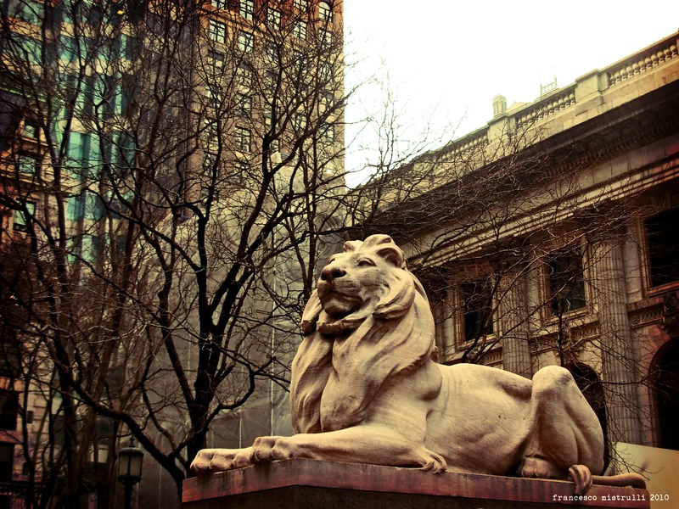
Notes:
(Patience, the lion on the left of the NY Public Library)
Not expecting overnight success
Building resource and changing community go hand-in-hand
Changing community is harder/longer process
Ten-year plan

Slide 28
Are we having any effect?
Notes:
But the big question is, Are we having an effect on the community? Are people changing their behavior?

Slide 29
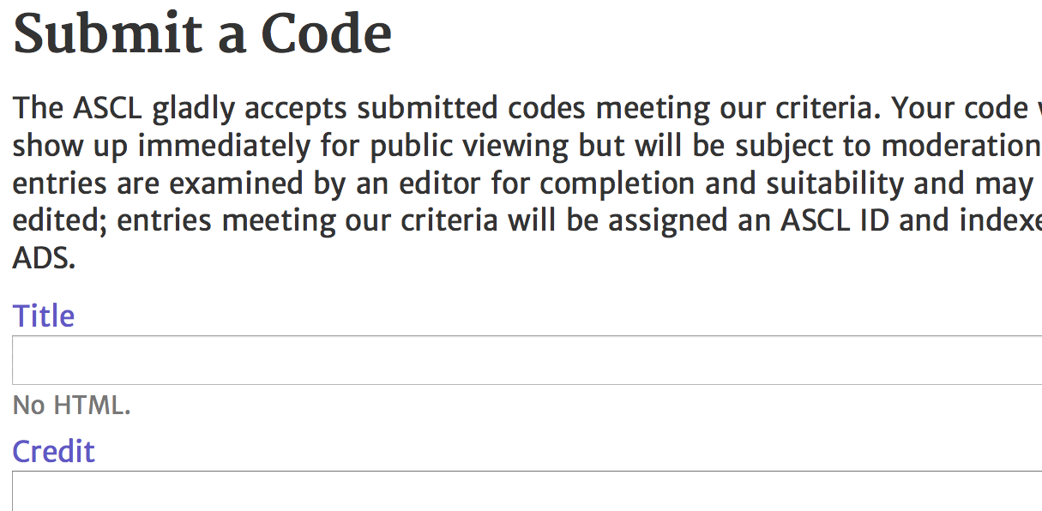
Notes:
Well, it appears so; for one, some journal editors are now encouraging authors to register new software with the ASCL before a paper is published.
They can use the ASCL ID in the paper, and make it a link to the ASCL entry in the online version of the paper.
We see more submissions now, too, independent of the advocacy of journal editors. 80 codes have been submitted by their authors since July of last year, more than had been submitted by authors in all the previous years combined.

Slide 30
Percentage of code entries
in ASCL with citations
Notes:
Authors are using the ASCL to cite codes. Last January, I started tracking how many ASCL entries have been cited, and as this chart demonstrates, the %age of codes cited is increasing, and the rate of increase of citations is faster than the rate of growth of ASCL entries. The ASCL grew 31% last year, while citations grew 63%. The ASCL has made it possible to cite software that does not have a descriptive paper in the literature to use for citation.
The second largest source of referral traffic to the ASCL comes from ADS, which means people are finding links to code entries there and following them to the ASCL – codes are more easily discoverable.

Slide 31
Wider efforts
Workshop on Sustainable Software for Science: Practice and Experiences (WSSSPE)
Preserving.exe @ Library of Congress
National Academies of Science workshop
NSF Cyberinfrastructure meeting
Notes:
The ASCL reaches out beyond astronomy, participating in workshops and meetings with those from other disciplines who are also encouraging more transparent science, better scientific software, and more reproducible research.

Slide 32
Questions and discussion
Notes:
Thanks very much for your attention!

