Slide 1
Restoring reproducibility: Making scientist software discoverable
Alice Allen
Astrophysics Source Code Library
ascl.net
Notes:
Here to talk about the effort in astronomy to make research software available for examination: the Astrophysics Source Code Library (ASCL), which is an online registry scientist written software used in research
Challenges of creating and growing the resource
Specific steps the ASCL has taken to encourage use of resource and to improve code discovery in astronomy
Effect this work is having within the community

Slide 2
Research software
Integrity of research depends on transparency and reproducibility
“… anything less than release of actual source code is an indefensible approach for any scientific results that depend on computation...”
Ince, Hatton, & Graham-Cumming, The case for open computer programs, Nature, v. 482, Feb. 23, 2012
Notes:
That software is important in research – it is a method and that method should be available so that others can examine it.
Or to paraphrase a bit in Nature in 2012: not making the software available is indefensible
And that is why the ASCL was created in 1999 – to make the source codes – the software -- used in astronomy available for examination.
We’ll first look at ASCL’s history
Then discuss what we learned along the way
How we put the lessons to use and finally
Effects of our work

Slide 3
ASCL A brief history
Notes:
So here is a brief history of the ASCL… I’m going to leave out a lot, but I’m happy to talk about it later if you’d like. Basically, it has had three phases:
1999-2003
Dormancy
2010-present

Slide 4
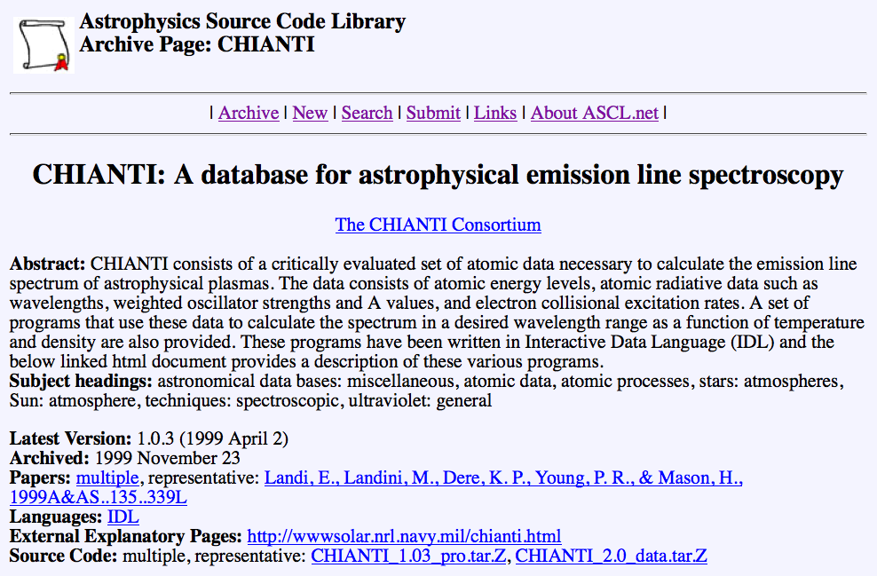
Code entry, 1999
Notes:
Started by Robert Nemiroff in 1999 – to make the source codes – the software -- used in astronomy available for examination.
This is what the first version looked like…. One HTML page/code, with 10 fields, including subject headings, version number, language(s), and a link to the deposited code
Repository
Subject headings categorized the codes, and these headings were used on an index page that listed all codes

Slide 5
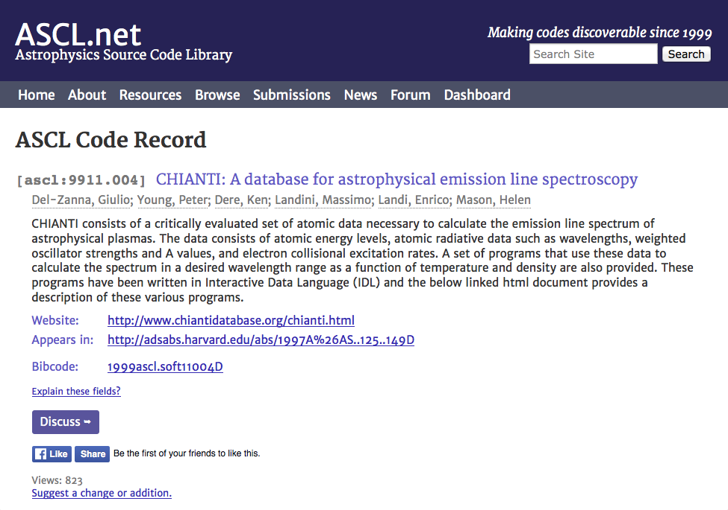
Code entry, present
Notes:
And this is what it looks like now. As you can see, the look is more professional. We retained most of the metadata from the previous version, but dropped more ephemeral metadata such as version. We also dropped the requirement to have the code deposited, and added a unique identifier, the ASCL ID.
We use WordPress for content management and news (our blog), and have an online submissions forms. The MySQL database allows us to better integrate with ADS, the primary indexer of astro journals; we create the bibcode ADS uses for our entries, and added the link to the ADS entry for our record to the page.

Slide 6
Home page, 2003
Notes:
Can see here the index page, the home page of the original site.

Slide 7
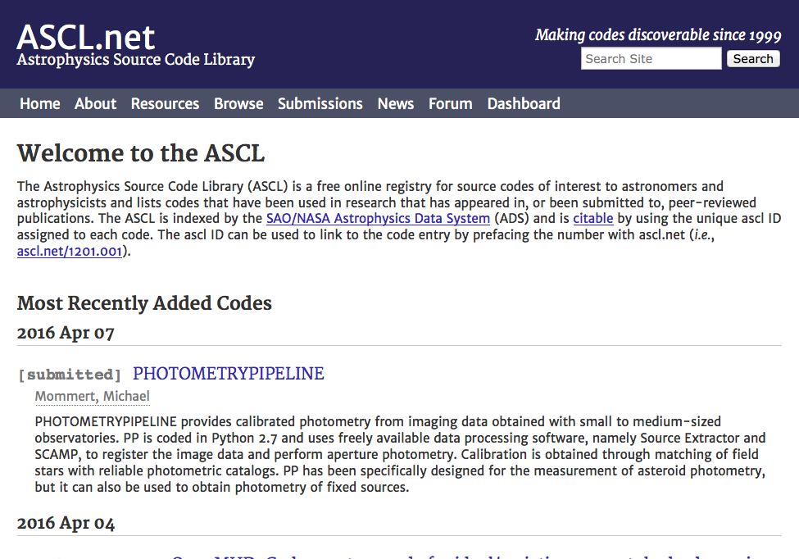
Home page, present
Notes:
This is the home page. It is much cleaner and lists the 10 newest codes right on the page in reverse date order, making it easy for people to see what’s new.

Slide 8
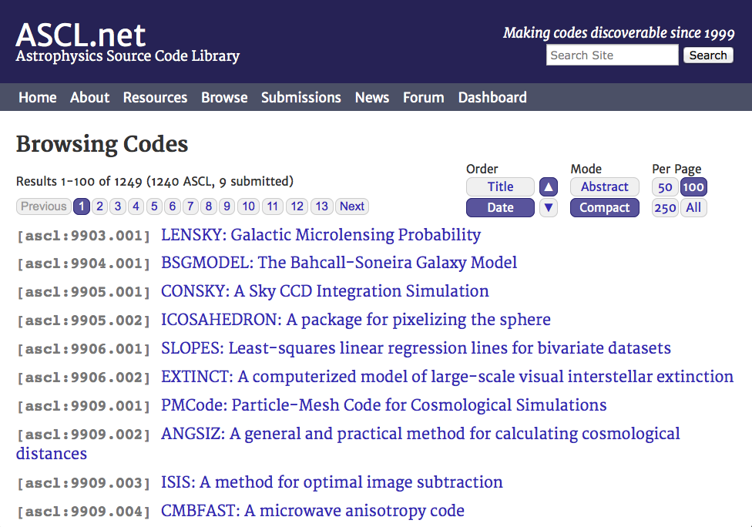
Browse, present
Notes:
Browsing options were expanded, too; this shows a compact browsing screen, which lists just the ASCL ID and the name of the software; there is an expanded mode that displays abstracts, too.
two presentations at major astronomy meetings: 1999 and 2000
37 codes
Search for new editor in 2003 was unsuccessful
Entered period of dormancy as other similar efforts were started
Continued to be available to anyone who could find it; lots of old links to it

Slide 9
Looking around and back
Why didn’t this work initially?
Who else has tried this?
What other similar efforts exist?
What can I learn from them?
Notes:
When I took over the ASCL in 2010, I wondered “Why didn’t this catch on? Who else has tried this? Have there been other similar efforts, and if so, what can I learn from them, and the ASCL’s early try, too?” I found others, even one that had started before the ASCL, some funded, some not, none of those still existing very active.
I asked some of those involved in these other efforts what had worked well and what had not worked for them.
ASDS (most robust; funded; 1993-2000)
AstroForge (funded, 2003-2006)
SkySoft (2003-present)
Astro-Code Wiki (2006-2011)
Astro-Sim (2007-2010)
AstroShare (2008-2014; last update 2012)

Slide 10
Lessons learned
People don’t want to deposit their codes/like to keep their codes nearby
Little incentive to register software
Don’t want to go first
Don’t want to have another site to update
Funding cycle not long enough to get uptake by community
Authors will not update metadata
Limited marketing limited growth
Notes:
So with these lessons in mind, the question then how do we use what we’ve learned? How do we encourage software release in the community? Framed this way, it’s a change management issue, and change management has been well-studied and offers guidance.

Slide 11
To bring about change…
Build it
Enlist/involve others
Market, market, market
Engage the community
Learn what barriers and incentives exist
Mitigate barriers and nurture incentives
Be patient
Notes:
Here are the most important steps we identified as necessary to change astronomy to a community that shares software more openly and that can guide the ASCL to being more widely adopted.
Let’s look at each step in more depth.

Slide 12
Total code entries by quarter July, 2010 - September, 2011
Notes:
Make it look like something. A few codes with the most recent submission having been in 2003 weren’t going to entice anyone to use the site.
Since software authors won’t enter their codes, I decided we’d take on that task.
The first 1.5 years I worked on the ASCL, much of my time was spent simply tracking down and entering codes.
This graph shows the results of that work, and was created for the first presentations on the ASCL since 2000.

Slide 13
Number of code entries at year end, 2010 - 2015
Notes:
We’ve continued to build it, and this is easier now as more and more, software authors are submitting their codes. We now have over 1200 codes in the ASCL

Slide 14
Advisory Committee
Notes:
To enlist and involve others, we created an advisory committee. We selected people who provide credibility and knowledge
To inform effort
To serve as change champions
Enlisted people prominent in astro software community, computer science professors with ties to other fields, and others
Eight members on advisory committee by end of 2011; ten members currently
Email others interested in code release and sharing to let them know the ASCL exists

Slide 15
Get the word out
Notes:
Market, market, market! The chair of the ASCL AC and I devised a marketing plan for the ASCL, which includes
Linking from Astronomy Picture of the Day (APOD) to ASCL
Participating in meetings/conferences and associated papers
Writing to code authors upon software registration
Writing guest posts for popular astro blogs
Getting involved in open science discussions with others
Using social media – Facebook, Twitter, and G+

Slide 16
Community work
Notes:
Educate and engage the community
Organize sessions at astronomy meetings
Split allotted time between presentations and open discussion with attendees to learn:
Barriers to code sharing
Incentives to encourage sharing
Community expectations

Slide 17
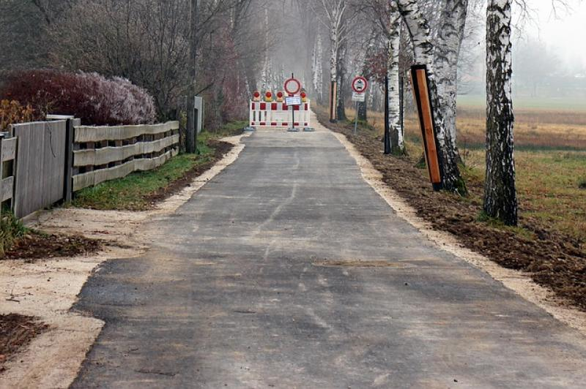
Notes:
Barriers
No payback/benefit to sharing software
Not required to, so don’t/too busy to do more work
Fear of judgment for “messy” code
Fear of losing competitive edge
University policies
Expectation of support from community
http://www.pd4pic.com/road-works-site-street-away-barrier-warning-stop.html

Slide 18
No one can assume that valuable innovations will pop up magically in the public domain if their inventors received no reward for their labor and capital.
Richard Epstein
Notes:
Incentives:
Citations for software/tracking citations
Greater recognition for code contribution
Complying with funding requirements
Future funding/peer review
Meet changing/new expectations

Slide 19
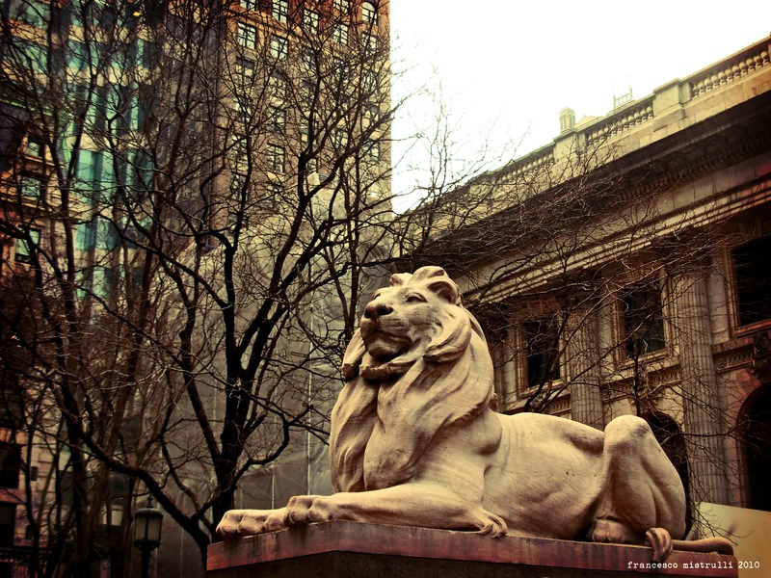
Notes:
(Patience, the lion on the left of the NY Public Library)
Not expecting overnight success
Building resource and changing community go hand-in-hand
Changing community is harder/longer process
Ten-year plan

Slide 20
Are we having any effect?
Notes:
But the big question is, Are we having an effect on the community? Are people changing their behavior?

Slide 21
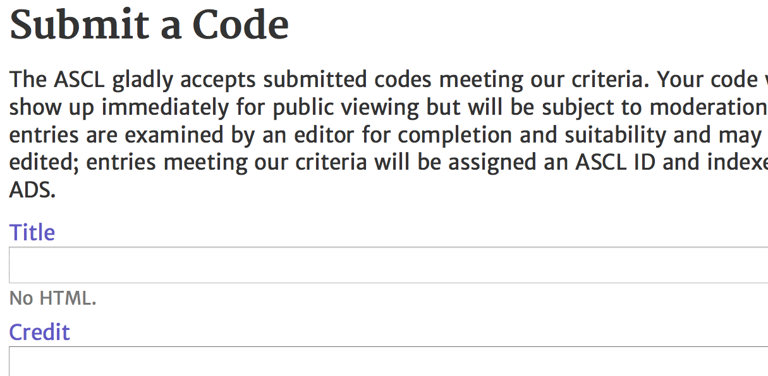
Notes:
Well, it appears so; for one, some journal editors are now encouraging authors to register new software with the ASCL before a paper is published.
They can use the ASCL ID in the paper, and make it a link to the ASCL entry in the online version of the paper.
We see more submissions now, too. 40% of the codes added to the ASCL since July 2014 were submitted by their authors, whereas before that, only a handful of entries had been submitted.
Every major astro journal accepts citations to the ASCL.

Slide 22
Citations to ASCL entries by year
Notes:
Citations to ASCL entries are generally more than doubling every year, as you can see from this chart.
The ASCL has made it possible to cite software that does not have a descriptive paper in the literature to use for citation.
The second largest source of referral traffic to the ASCL comes from ADS, which means people are finding links to code entries there and following them to the ASCL – codes are more easily discoverable.

Slide 23
Things I didn’t say but would
have with more time…
We have automated some manual processes and will automate others as time/volunteer work/ideas/funding allow, but ASCL will always need human editors.
ASCL has had little funding in the past; $5K from AAS for outreach one year, and for this year, Heidelberg Institute for Theoretical Studies (HITS) has provided €6K in (unsolicited!) funding. (We’re very grateful!) Consistent funding is on my to do list, and we are looking at perhaps gathering small amounts of funding annually ($500-$1000) from broad group of organizations. ASCL is built using open source technologies: MySQL, CodeIgniter, phpbb, WordPress
Can be cloned; see offer here and an empty(ish) site here. I’ve had requests from physicists to create a physics source code library, and we are looking at other fields, including economics.
I get to meet the best people by working on this project! Thank you for being among them!
Template image credit and information: This image is an average of the central 10 velocity planes of a mosaic of five data cubes released as part of the Galactic Arecibo L-band Feed Array HI (GALFA-HI) survey (Peek et al., 2011, Ap J Suppl, 194, 20; DOI 10.1088/0067-0049/194/2/20; ADS Bibcode 2011ApJS..194...20P). The mosaic was with computed version 4.0 of the Montage Image Mosaic Engine. Image courtesy John Good and Bruce Berriman, California Institute of Technology.

