Slide 1
Research software best practices: Transparency, credit, and citation
Alice Allen
Astrophysics Source Code Library
ascl.net
Notes:
We’d heard about practices that can help in the software development life cycle. I will cover a few steps that you can take to strengthen research and recognize the contribution of software to the community, and tell you a bit about the Astrophysics Source Code Library and how it can help.

Slide 2
Research software
Integrity of research depends on transparency and reproducibility
“… anything less than release of actual source code is an indefensible approach for any scientific results that depend on computation...”
Ince, Hatton, & Graham-Cumming, The case for open computer programs, Nature, v. 482, Feb. 23, 2012
Notes:
Most astronomers depend on software do to their research – it is a method and that method should be available so that others can examine it.
Or to paraphrase a bit in Nature in 2012: not making the software available is indefensible

Slide 3
Efforts Underway
Workshop on Sustainable Software for Science: Practice and Experiences (WSSSPE)
CodeMeta project
Force11 Software Citation Working Group
Center for Open Science's Transparency and Openness Promotion (TOP) Guidelines
Engineering Academic Software at Dagstuhl
Notes:
WSSSPE: Multi-disciplinary, international, community-driven effort; four yearly meetings with a couple of smaller interim meetings. Advocates for best practices in software sustainability and career paths for software authors, and works to improve recognition of research software as an intellectual contribution equal to other research products. First meeting was in 2013; reports from its meetings are available online.
CodeMeta: relatively small group of people involved in data and software repositories and registries; it is creating a crosswalk table, a “Rosetta stone” for software metadata standards already in place. This will help facilitate the movement of metadata about software – and citations to it.
Force11: Future of Research Communications. Grew out of a workshop held in Dagstuhl in 2011. Seeks to improve knowledge creation and sharing by leveraging technology for media-rich digital publishing of scholarly outputs, including data and software. It has published software citation principles.
Center for Open Science: founded in 2013, it seeks to remove barriers to sharing, and to increase transparency and replicability of research. Its strategic plan states that “openness with data, methods, and tools makes them citable contributions.” Its Transparency and Openness Guidelines advocate for code accessability.
Engineering Academic Software at Dagstuhl: held in June 2016; its manifesto addresses software citation

Slide 4
Force11 Software Citation Principles
Importance
Credit and attribution
Unique identification
Persistence
Accessibility
https://peerj.com/articles/cs-86/
Notes:
Importance: Software should be considered a legitimate and citable product of research.
Credit and attribution: Software citations should facilitate giving scholarly credit
Unique identification: A software citation should include a method for identification that is globally unique and recognized by at least a community of the corresponding domain experts
Persistence: Unique identifiers and metadata describing the software and its disposition should persist—even beyond the lifespan of the software they describe.
Accessibility: Software citations should facilitate access to the software itself and to its associated metadata, documentation, data, and other materials necessary for both humans and machines to make informed use of the referenced software.

Slide 5
Dagstuhl Manifesto on Citation
I will make explicit how to cite my software.
I will cite the software I used to produce my research results.
When reviewing, I will encourage others to cite the software they have used.
https://dl.dropboxusercontent.com/u/11565521/dagstuhl-eas-manifesto-2016-12-02.pdf
Notes:
The Dagstuhl Manifesto focused on steps that members of a research community can take on their own; these actions are ones that most astronomers can start doing immediately.

Slide 6
Astrophysics Source
Code Library
(ASCL, ascl.net)
Notes:
Effort to encourage and support transparency of research. If you are reading a paper and come across the name of a code, you should be able to look through the source code, to examine it, see what assumptions and calculations were made.
Started in 1999

Slide 7
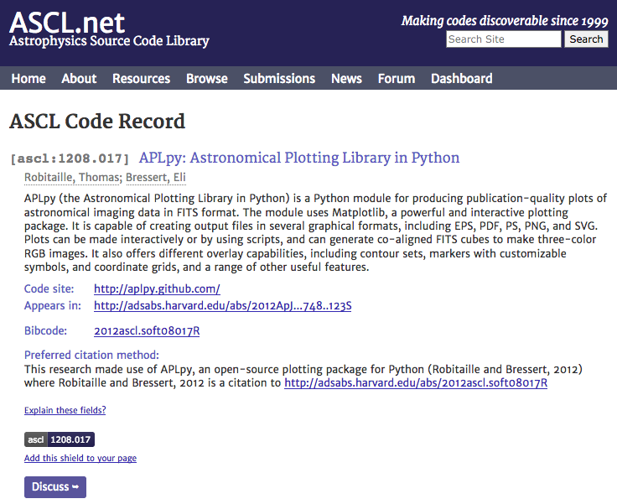
Notes:
And here’s a typical record.
We use WordPress for content management and news (our blog), and have an online submissions forms. The MySQL database allows us to better integrate with ADS, the primary indexer of astro journals; we create the bibcode ADS uses for our entries, and added the link to the ADS entry for our record to the page.

Slide 8
Number of code entries at year end, 2010 - 2016
Notes:
We currently have 1485 codes in the ASCL.

Slide 9
Notes:
Barriers
No payback/benefit to sharing software
Not required to, so don’t/too busy to do more work
Fear of judgment for “messy” code
Fear of losing competitive edge
University policies
Expectation of support from community
http://www.pd4pic.com/road-works-site-street-away-barrier-warning-stop.html

Slide 10
No one can assume that valuable innovations will pop up magically in the public domain if their inventors received no reward for their labor and capital.
Richard Epstein
Notes:
Incentives:
Citations for software/tracking citations
Greater recognition for code contribution
Complying with funding requirements
Future funding/peer review
Meet changing/new expectations

Slide 11
Cumulative number of citations to ASCL entries in ADS by year
Notes:
Citations to ASCL entries are generally more than doubling every year, as you can see from this chart.
The ASCL has made it possible to cite software that does not have a descriptive paper in the literature to use for citation.
The second largest source of referral traffic to the ASCL comes from ADS, which means people are finding links to code entries there and following them to the ASCL – codes are more easily discoverable.

Slide 12
Citations by journal
Notes:
ADS shows that 58 journals it indexes have citations to ASCL entries. In addition to being indexed by ADS, Web of Science also indexes the resource.

Slide 13
Benefits of the ASCL
Improves transparency of research
Aids in software discovery
Provides way to cite software separately from papers
Assigns DOIs for codes housed on ASCL
Reliability of data
Notes:
ADS shows that 58 journals it indexes have citations to ASCL entries. In addition to being indexed by ADS, Web of Science also indexes the resource.
Transparency: links software with research that uses the software
Discovery: Google/Google Scholar, ADS, WoS
Citation: Journals don’t want to link to your website! Citations tracked by ADS and WoS Authors accrue credit for valuable contributions to science
DOIs: for those who want them
Reliability: Actively curated

Slide 14
You can change the world! (Or at least a little piece of it!)
Release your code
Specify how you want your code to be cited
License your code
Register your code
Archive your code somewhere
Notes:
Release your code so others can at least read through it
Specify citation method: Choose a trackable way/Put this information where easily seen
License your code so others know how to use it
Register your code in the ASCL
Archive your code somewhere so it’s not lost to science/remains to complete the research record

Slide 15
Dagstuhl Manifesto on Citation
I will make explicit how to cite my software.
I will cite the software I used to produce my research results.
When reviewing, I will encourage others to cite the software they have used.
https://dl.dropboxusercontent.com/u/11565521/dagstuhl-eas-manifesto-2016-12-02.pdf

