Slide 1
The Role of the ADS
in Software Discovery and Citation
Alberto Accomazzi Edwin Henneken, Sergi Blanco Cuaresma
@aaccomazzi
AAS 231st Meeting - 1/11/2018

Slide 2
ADS Core Responsibilities
Maintaining a comprehensive, timely and complete database of scholarly papers in Astronomy
Tracking citations to scholarly papers
Integrating in its database bibliographies and links to data products
Providing discovery services and metrics to researchers, librarians, collaborators

Slide 3
ADS Core Responsibilities v1.1
Maintaining a comprehensive, timely and complete database of scholarly papers in Astronomy
Tracking citations to scholarly papers
Integrating in its database bibliographies and links to data products
Providing discovery services and metrics to researchers, librarians, collaborators

Slide 4
ADS Core Responsibilities v1.1
Maintaining a comprehensive, timely and complete database of scholarly papers works in Astronomy
Tracking citations to scholarly papers
Integrating in its database bibliographies and links to data products
Providing discovery services and metrics to researchers, librarians, collaborators

Slide 5
ADS Core Responsibilities v1.1
Maintaining a comprehensive, timely and complete database of scholarly papers works in Astronomy
Tracking citations to scholarly papers content
Integrating in its database bibliographies and links to data products
Providing discovery services and metrics to researchers, librarians, collaborators

Slide 6
ADS Core Responsibilities v1.1
Maintaining a comprehensive, timely and complete database of scholarly papers works in Astronomy
Tracking citations to scholarly papers content
Integrating in its database bibliographies and links to data products and software
Providing discovery services and metrics to researchers, librarians, collaborators

Slide 7
How ADS selects and ingests content
In order for some work to be considered for inclusion in ADS it must be:
Scholarly in nature
Related to Astronomy
Published and (ideally) available online

Slide 8
How ADS selects and ingests content
In order for some work to be considered for inclusion in ADS it must be:
Scholarly in nature
Related to Astronomy
Published and (ideally) available online
If you want a record for your software included in ADS, publish it in a known repository or register it in ASCL

Slide 9
How ADS awards citations (“A cites B”)
The citing work A is in ADS
ADS has the the full-text or reference section of A available for analysis
The reference to B has been successfully identified
The citing work B is in ADS

Slide 10
How ADS awards citations (“A cites B”)
The citing work A is in ADS
ADS has the the full-text or reference section of A available for analysis
The reference to B has been successfully identified
The citing work B is in ADS
If you want your software citation to count, make sure it appears as a formal citation via a unique identifier

Slide 11
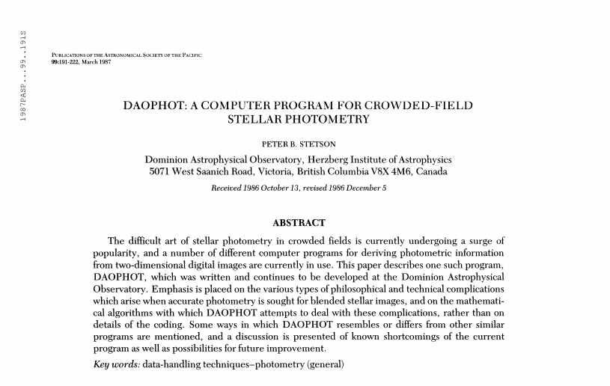
“Software” publishing and citation in 1987

Slide 12
“Software” publishing and citation in 1987

Slide 13
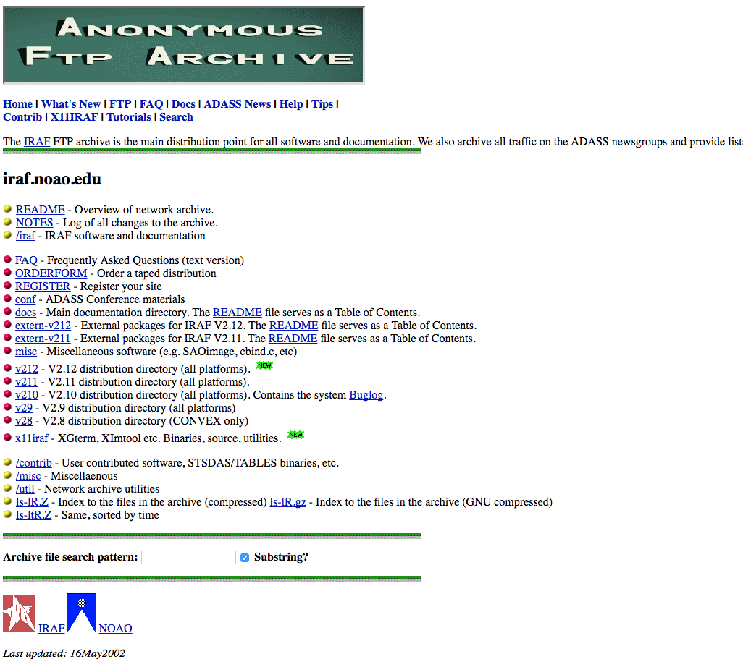
Software “publishing” and citation in 1997

Slide 14
Software “publishing” and citation in 1997

Slide 15
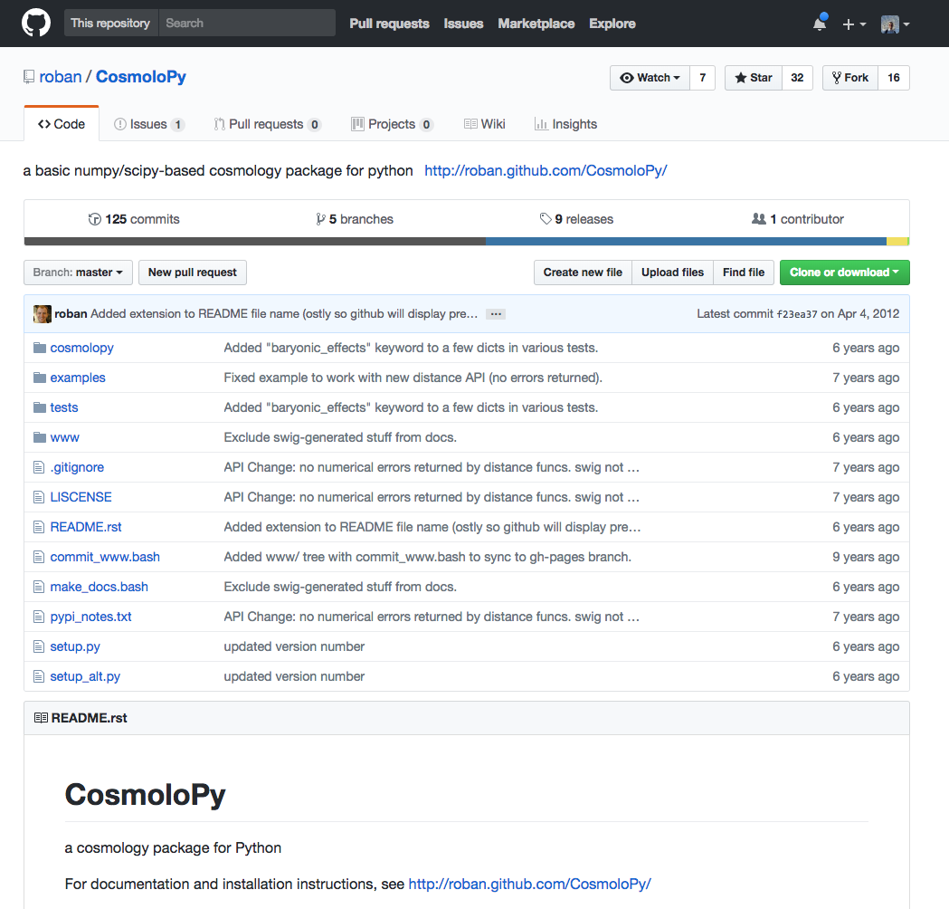
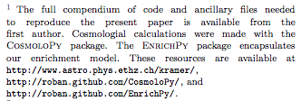
Software “publishing” and “citation” in 2010

Slide 16
Software “publishing” and “citation” in 2010

Slide 17
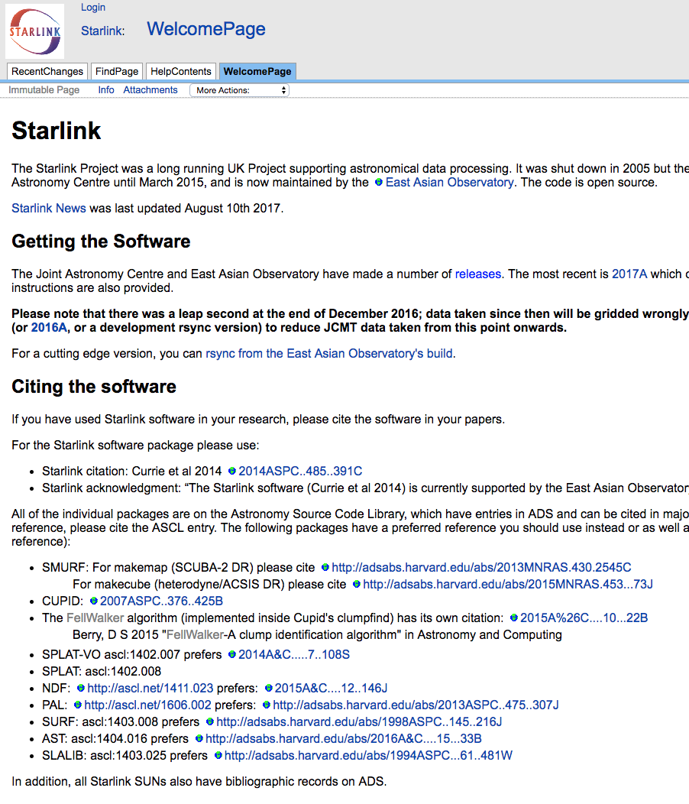
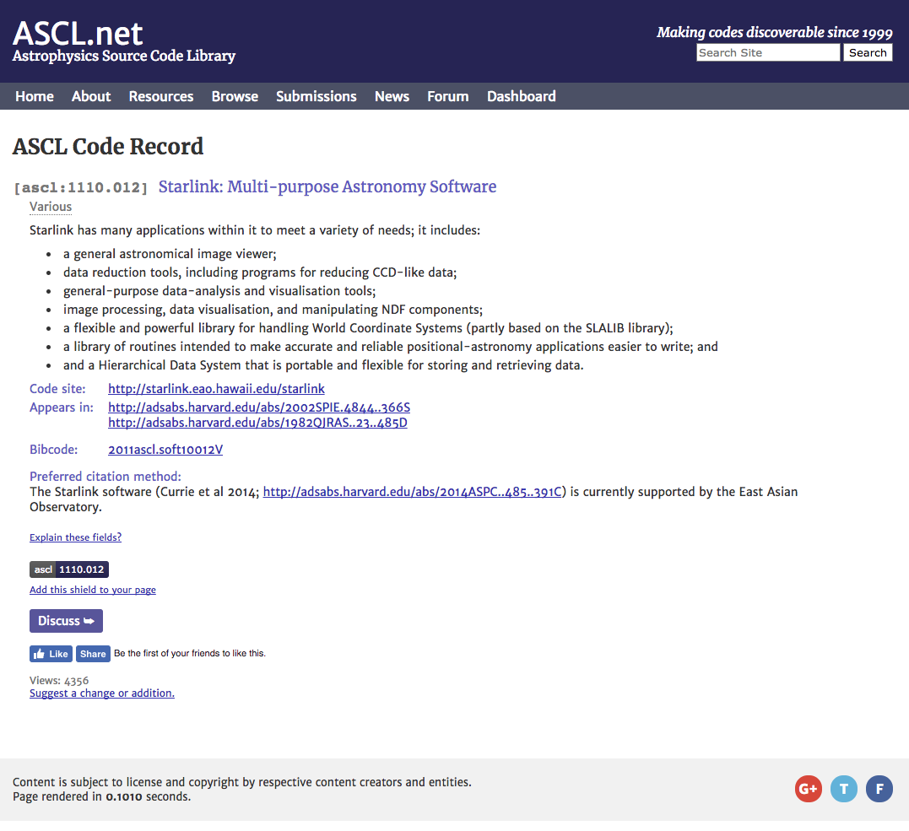
Software “publishing” and citation in 2012

Slide 18
Software “publishing” and citation in 2012

Slide 19
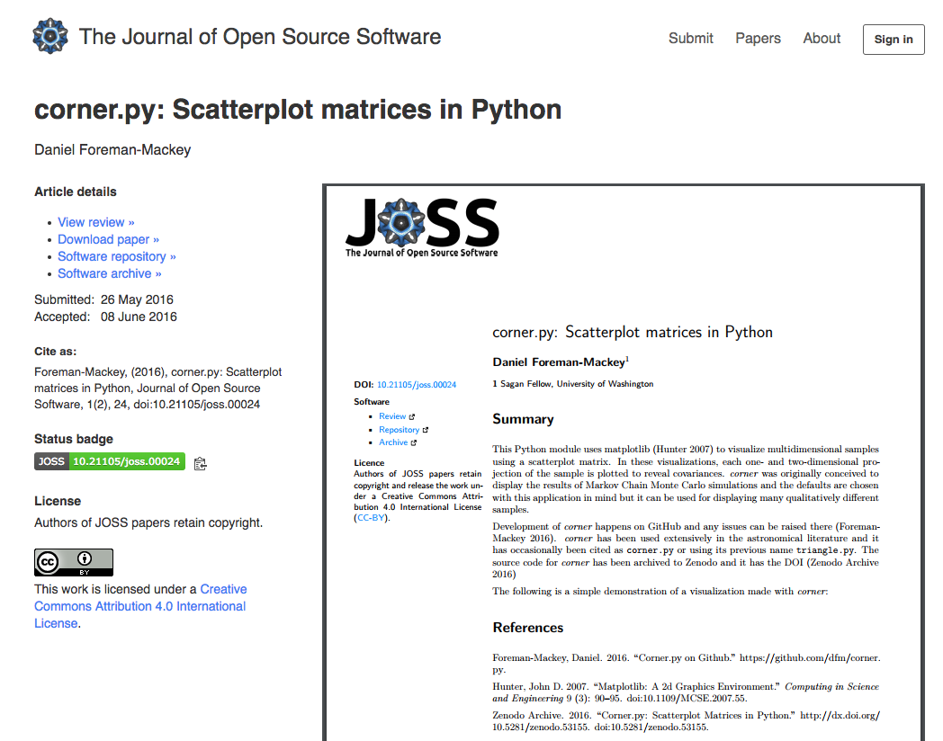
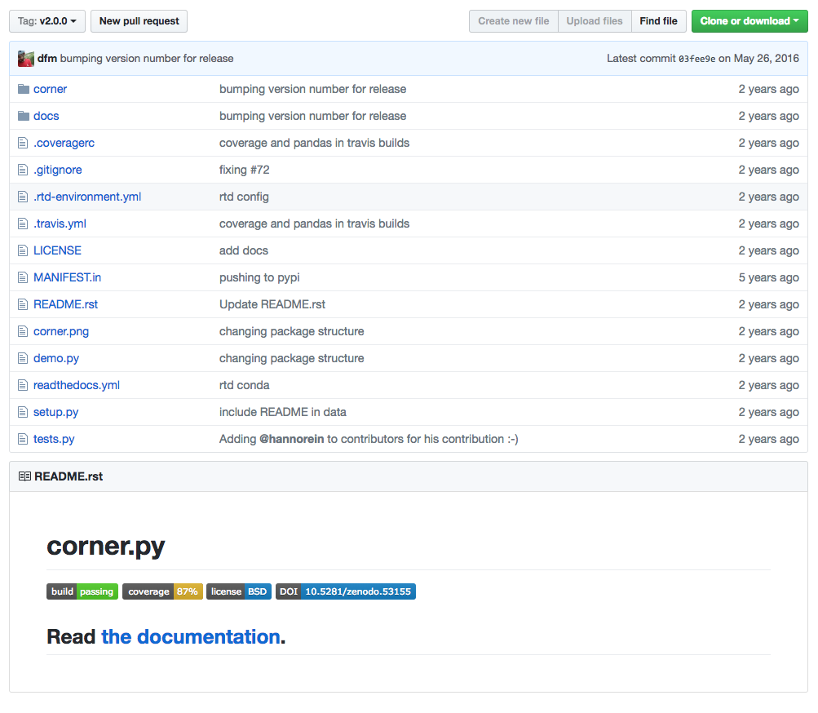
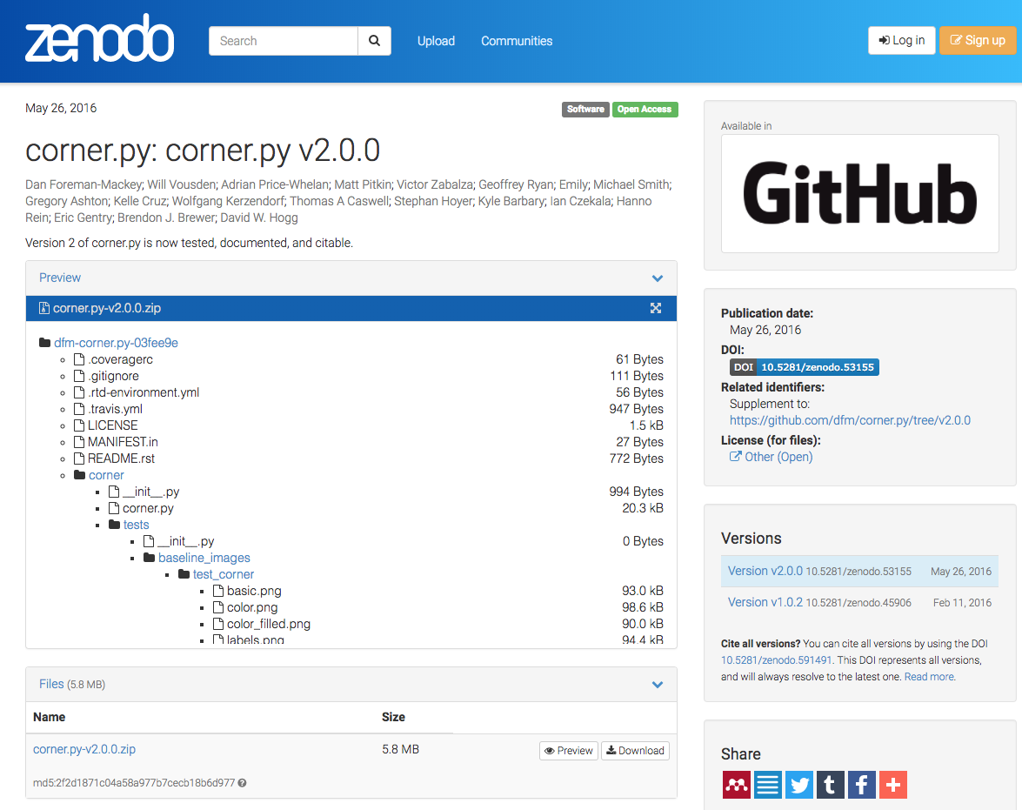
Software publishing and citation in 2016

Slide 20
Software publishing and citation in 2016

Slide 21
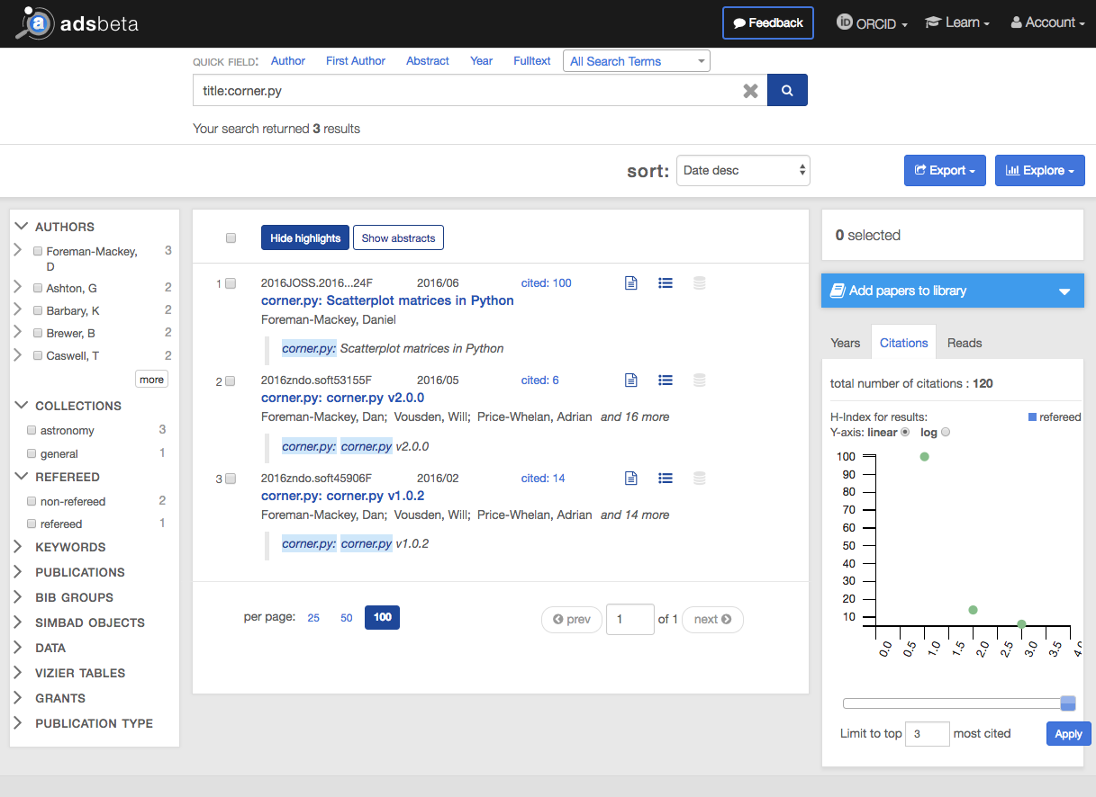
How is ADS dealing with this

Slide 22
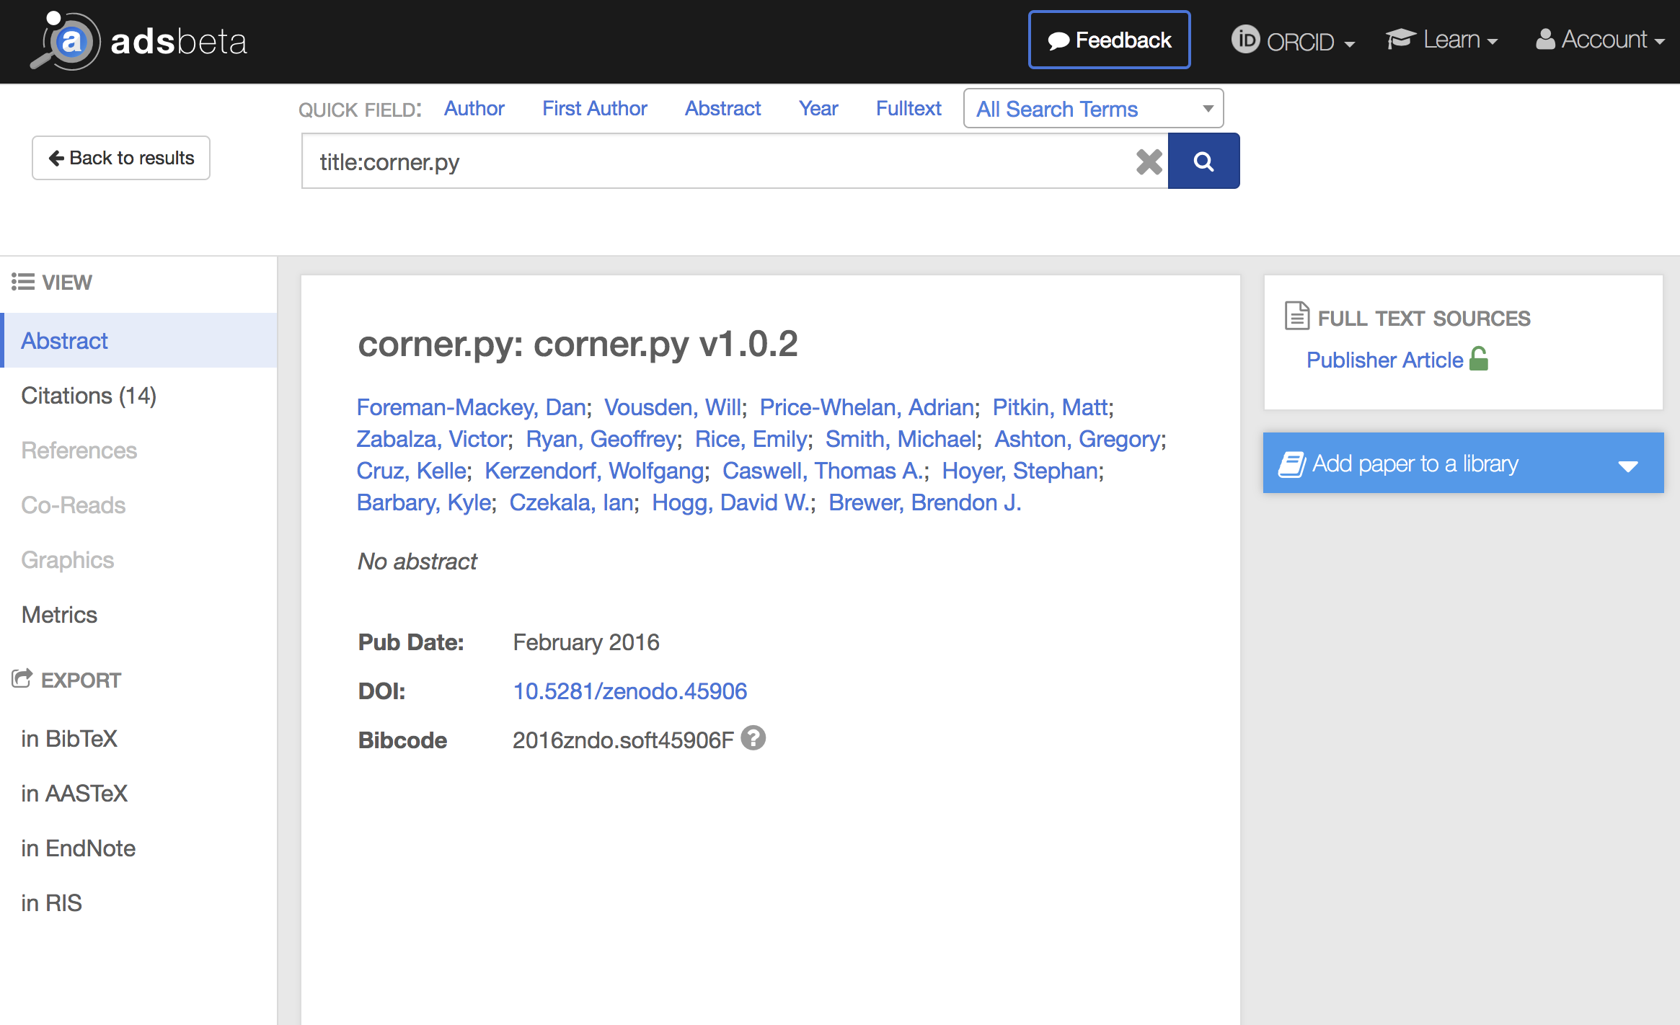
How is ADS dealing with this - today

Slide 23
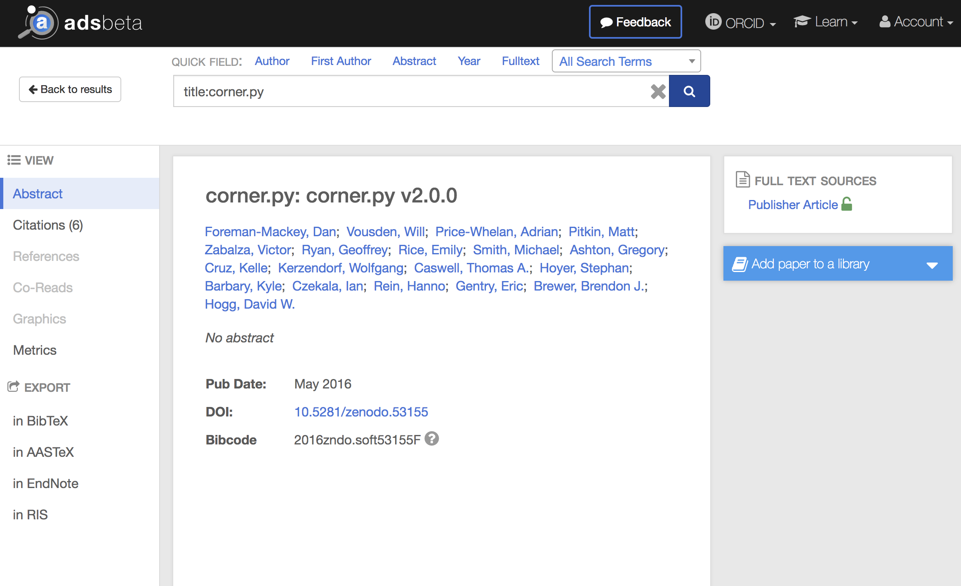
How is ADS dealing with this - today

Slide 24
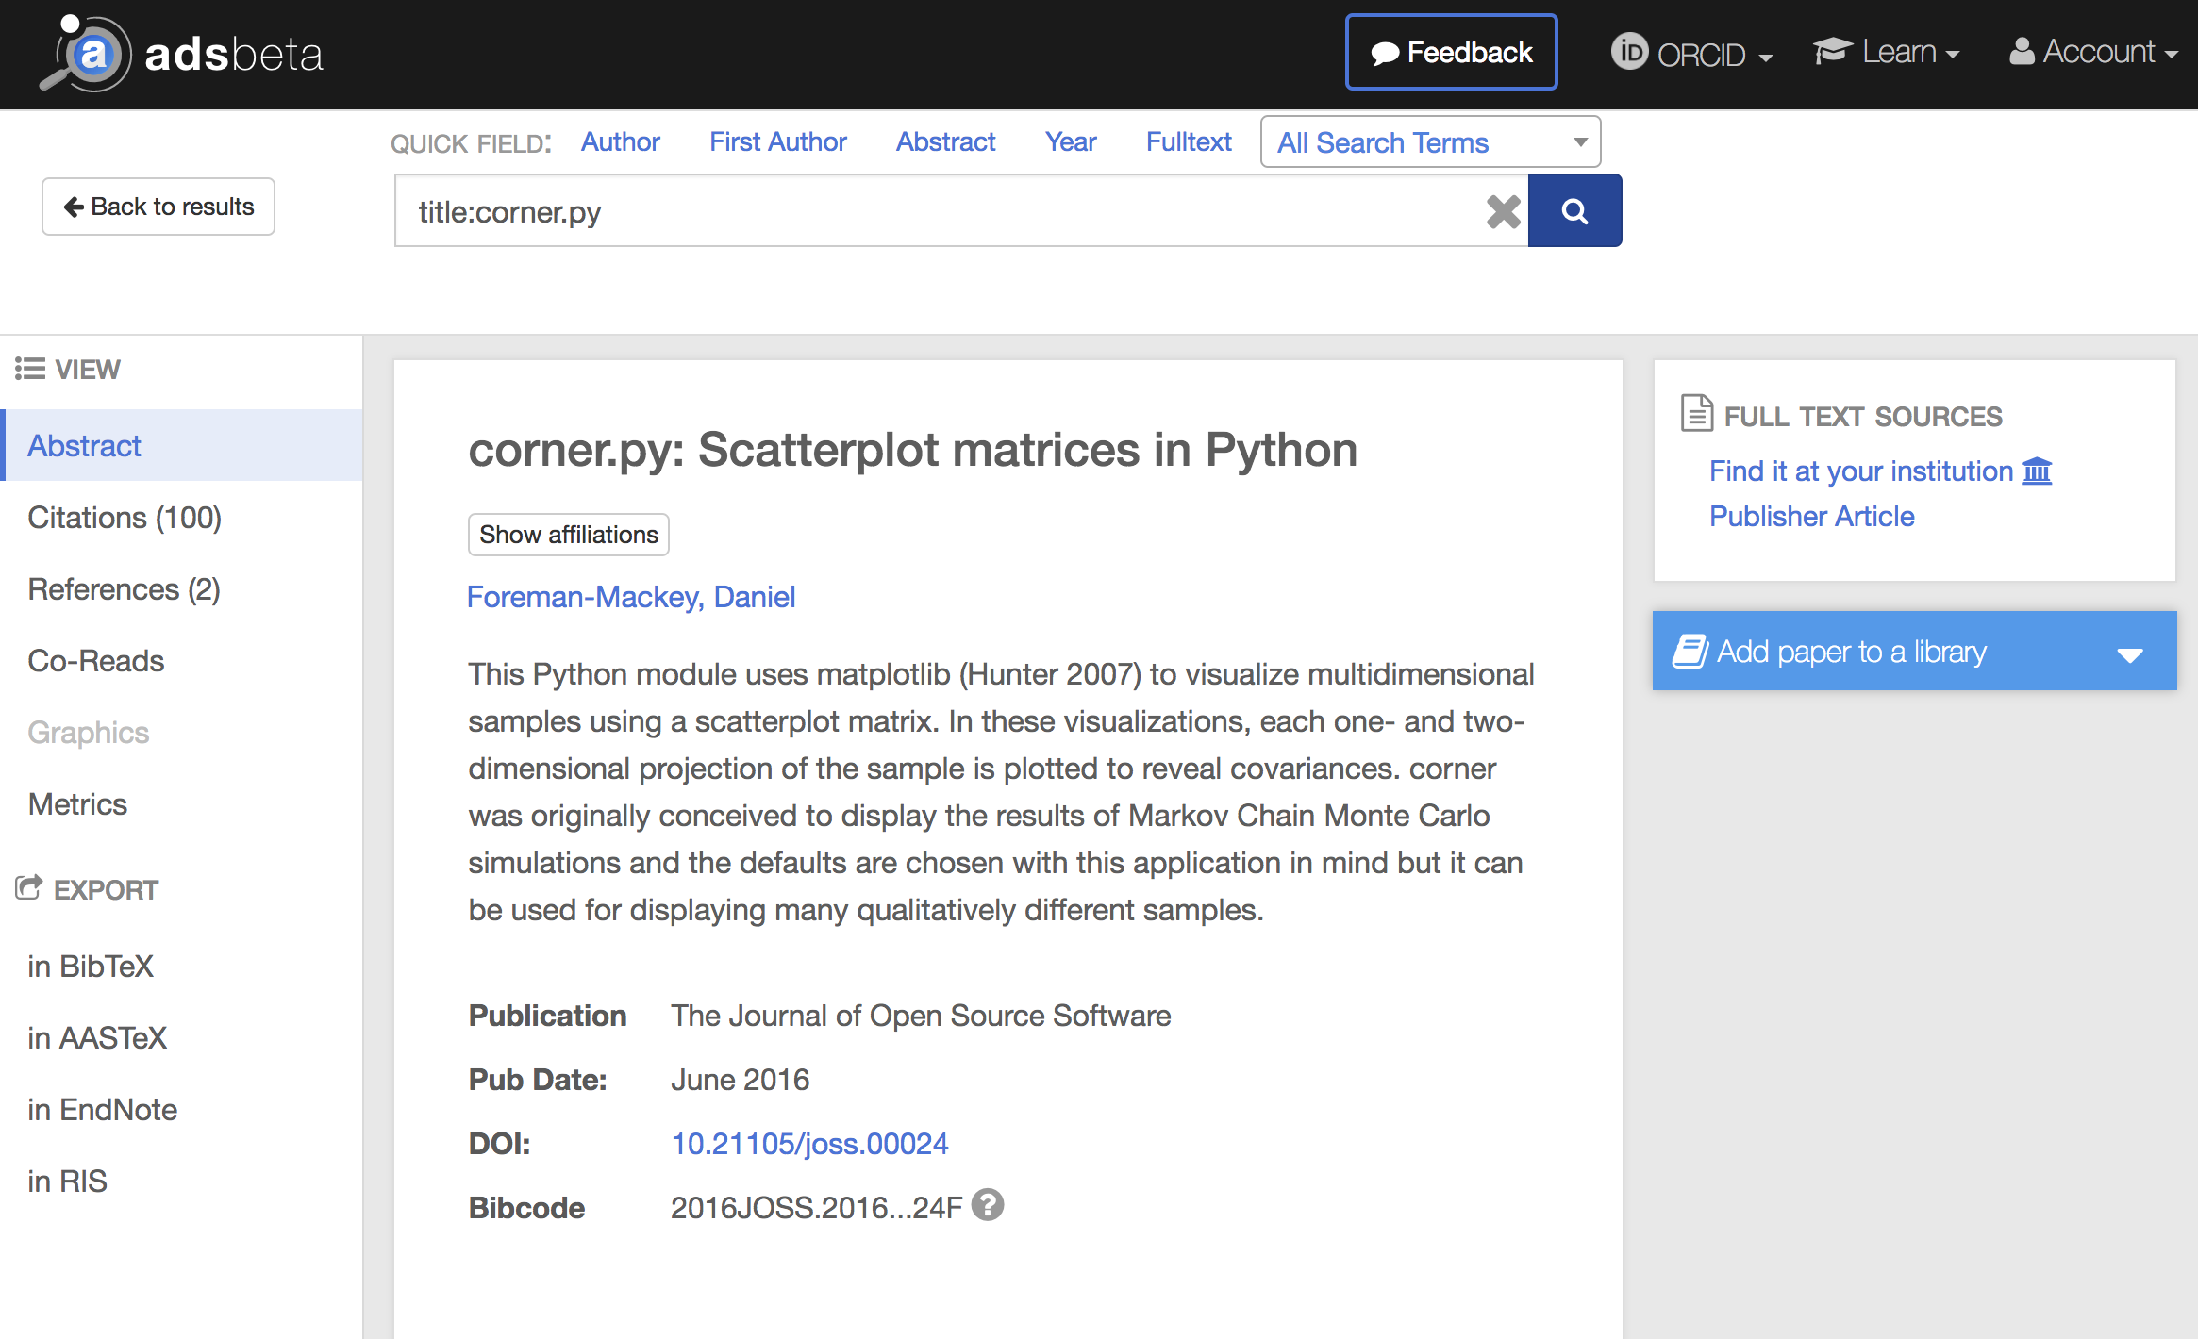
How is ADS dealing with this - today

Slide 25
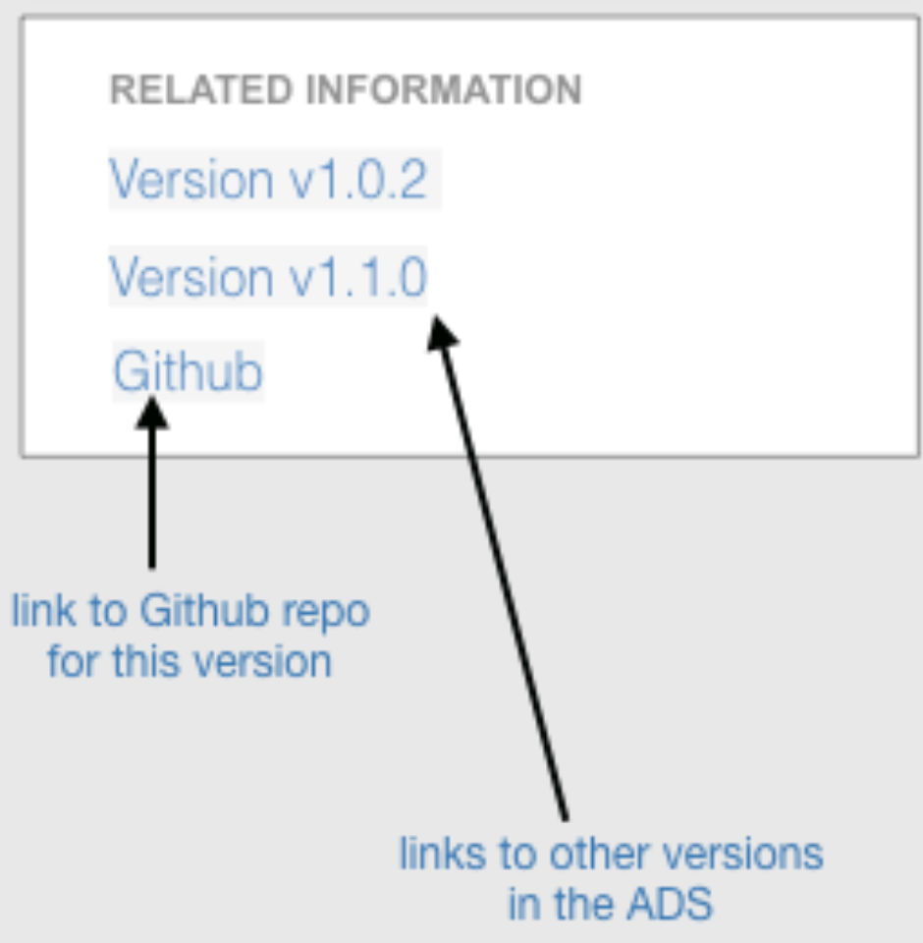
How is ADS dealing with this - tomorrow

Slide 26
How is ADS dealing with this - later this year
Software packages ingested in ADS upon the detection of a citation from the refereed literature via a DOI; citation awarded to identified (versioned) resource
Different software versions cross-linked in detail view
Eventually: cumulative metrics (citations, reads) available for versions of same software product
Citation event data publicly available through API

